Slide 1
Mathematical Induction: Introduction and basic problems
CMSC 250

Slide 2
Announcements / Reminders
If you are not seeing hw / quiz for this week, that’s good!
There aren’t any, midterm week!
COVID vaccine made you unable to sit for the exam yesterday?
No worries, we have prepared another exam for tomorrow, starting at 8am through Saturday at 8am.
See today’s announcement.
If you sat for it yesterday, you cannot re-sit for it if you don’t feel you did well!
We can easily determine this from Gradescope and simply erase submissions.
Exam schedule known from January, even before vaccinations started rolling out.

Slide 3
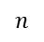
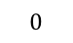

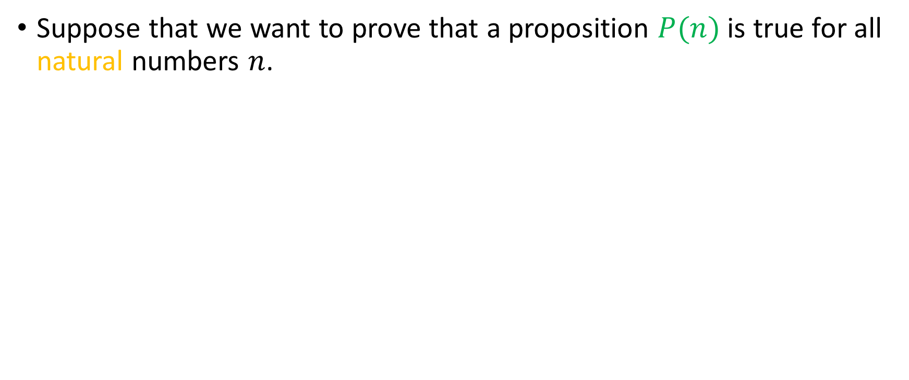


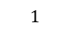
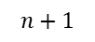
The idea behind induction
Suppose that we want to prove that a proposition $P(n)$ is true for all natural numbers $n$.
$$0$$
$$1$$
$$2$$
$$…$$
$$…$$
$$n$$
$$n+1$$
$$…$$
$$…$$
$$…$$

Slide 4
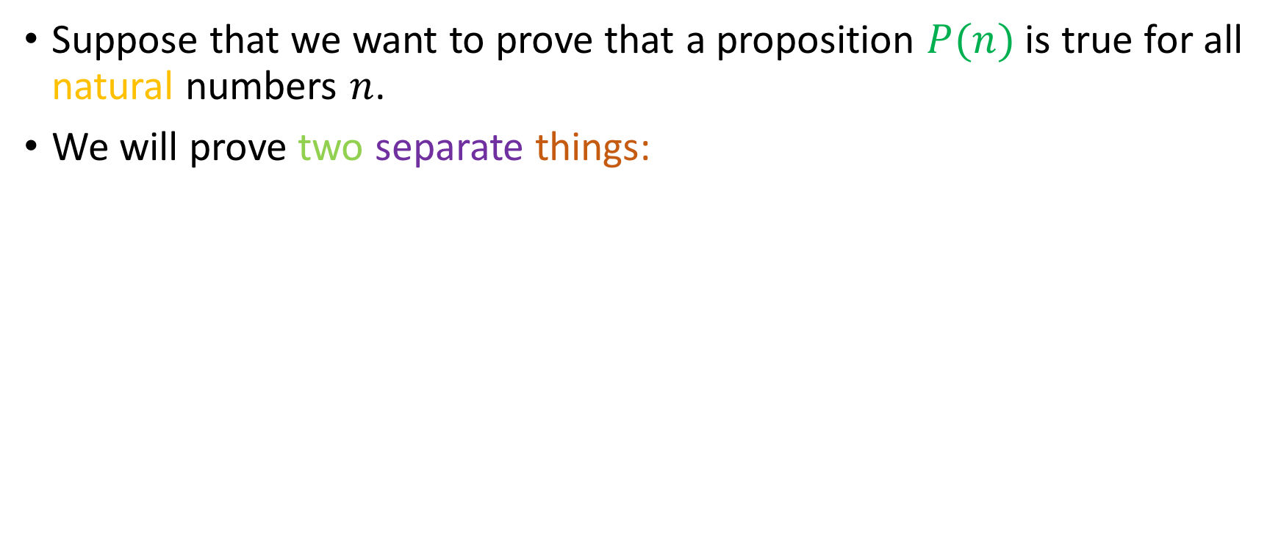
The idea behind induction
Suppose that we want to prove that a proposition $P(n)$ is true for all natural numbers $n$.
We will prove two separate things:
$$0$$
$$1$$
$$2$$
$$…$$
$$…$$
$$n$$
$$n+1$$
$$…$$
$$…$$
$$…$$

Slide 5

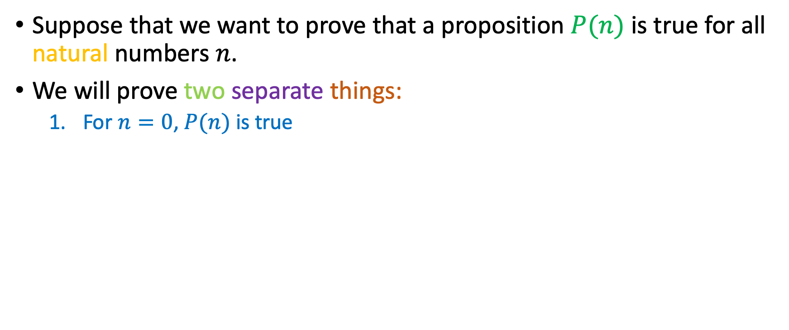
The idea behind induction
Suppose that we want to prove that a proposition $P(n)$ is true for all natural numbers $n$.
We will prove two separate things:
For $n=0$, $P(n)$ is true
$$0$$
$$1$$
$$2$$
$$…$$
$$…$$
$$n$$
$$n+1$$
$$…$$
$$…$$
$$…$$

Slide 6
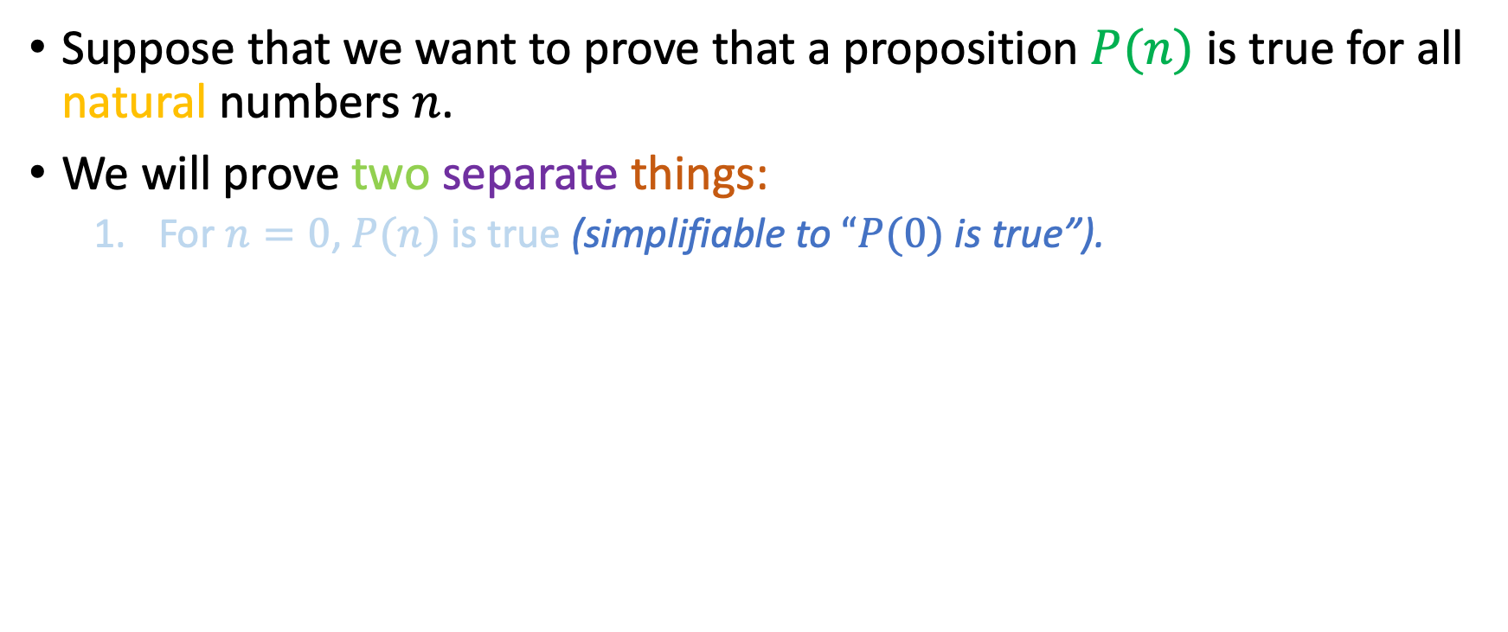
The idea behind induction
Suppose that we want to prove that a proposition $P(n)$ is true for all natural numbers $n$.
We will prove two separate things:
For $n=0$, $P(n)$ is true (simplifiable to $“P(0)$ is true”).
$$0$$
$$1$$
$$2$$
$$…$$
$$…$$
$$n$$
$$n+1$$
$$…$$
$$…$$
$$…$$

Slide 7
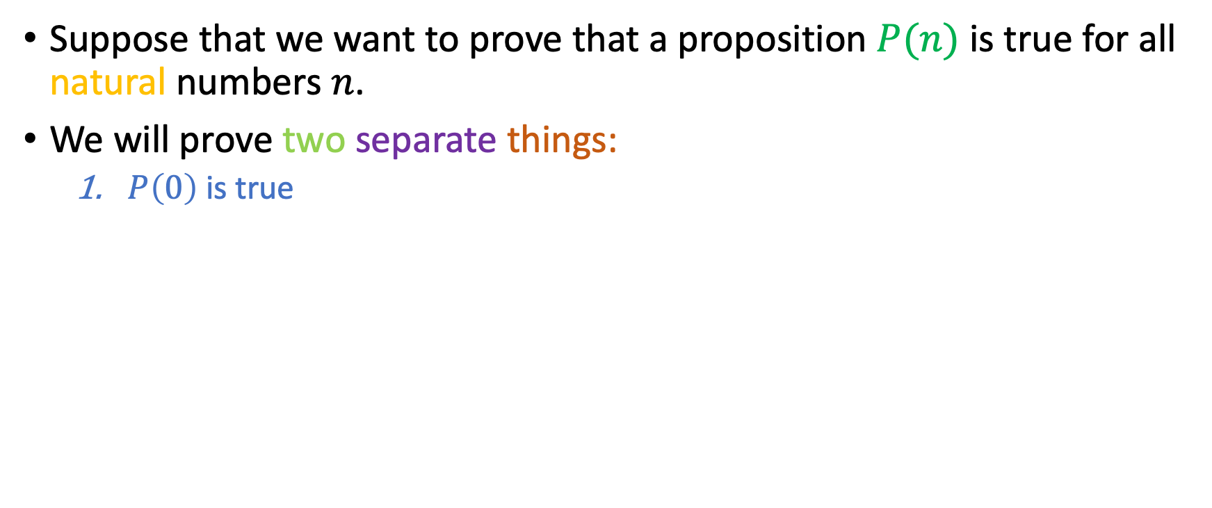
The idea behind induction
Suppose that we want to prove that a proposition $P(n)$ is true for all natural numbers $n$.
We will prove two separate things:
$P\left(0\right)$ is true
$$0$$
$$1$$
$$2$$
$$…$$
$$…$$
$$n$$
$$n+1$$
$$…$$
$$…$$
$$…$$

Slide 8
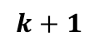
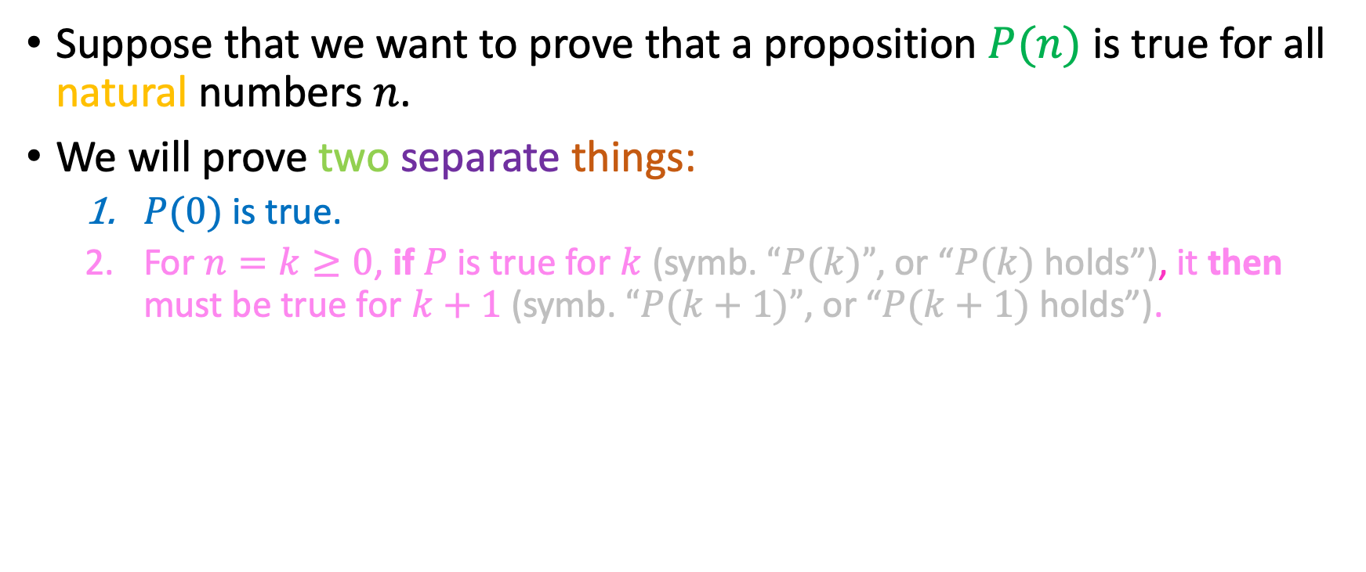
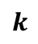

The idea behind induction
Suppose that we want to prove that a proposition $P(n)$ is true for all natural numbers $n$.
We will prove two separate things:
$P(0)$ is true.
For $n=k≥0$, if $P$ is true for $k$ (symb. $“P(k)”$, or “$P(k)$ holds”), it then must be true for $k+1$ (symb. $“P(k+1)”$, or “$P(k+1)$ holds”).
$$0$$
$$1$$
$$2$$
$$…$$
$$…$$
$$k$$
$$⇒$$
$$k+1$$
$$…$$
$$…$$
$$…$$

Slide 9
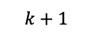
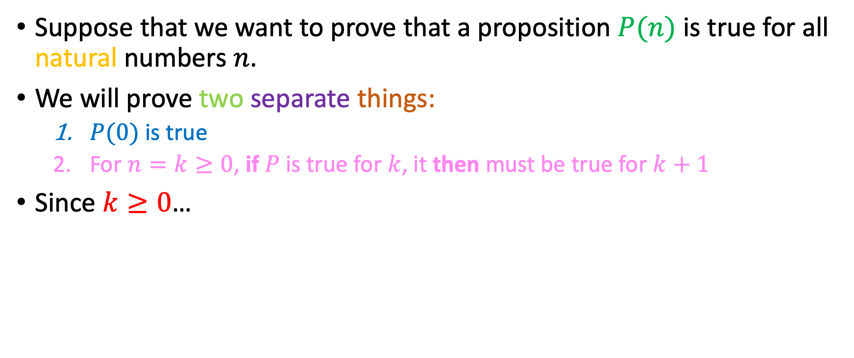
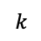
The idea behind induction
Suppose that we want to prove that a proposition $P(n)$ is true for all natural numbers $n$.
We will prove two separate things:
$P(0)$ is true
For $n=k≥0$, if $P$ is true for $k$, it then must be true for $k+1$
Since $k≥0$…
$$0$$
$$1$$
$$2$$
$$…$$
$$…$$
$$k$$
$$⇒$$
$$k+1$$
$$…$$
$$…$$
$$…$$

Slide 10

The idea behind induction
Suppose that we want to prove that a proposition $P(n)$ is true for all natural numbers $n$.
We will prove two separate things:
$P(0)$ is true
For $n=k≥0$, if $P$ is true for $k$, it then must be true for $k+1$
Since $k≥0$…
$$0$$
$$1$$
$$2$$
$$…$$
$$…$$
$$k$$
$$⇒$$
$$k+1$$
$$…$$
$$…$$
$$…$$

Slide 11
The idea behind induction
Suppose that we want to prove that a proposition $P(n)$ is true for all natural numbers $n$.
We will prove two separate things:
$P(0)$ is true
For $n=k≥0$, if $P$ is true for $k$, it then must be true for $k+1$
Since $k≥0$…
$$0$$
$$1$$
$$2$$
$$…$$
$$…$$
$$k$$
$$⇒$$
$$k+1$$
$$…$$
$$…$$
$$…$$

Slide 12


The idea behind induction
Suppose that we want to prove that a proposition $P(n)$ is true for all natural numbers $n$.
We will prove two separate things:
$P(0)$ is true
For $n=k≥0$, if $P$ is true for $k$, it then must be true for $k+1$
Since $k≥0$…
$$0$$
$$1$$
$$2$$
$$…$$
$$…$$
$$k$$
$$⇒$$
$$k+1$$
$$…$$
$$…$$
$$…$$

Slide 13
The idea behind induction
Suppose that we want to prove that a proposition $P(n)$ is true for all natural numbers $n$.
We will prove two separate things:
$P(0)$ is true
For $n=k≥0$, if $P$ is true for $k$, it then must be true for $k+1$
Since $k≥0$…
$$0$$
$$1$$
$$2$$
$$…$$
$$…$$
$$k$$
$$⇒$$
$$k+1$$
$$…$$
$$…$$
$$…$$

Slide 14
The idea behind induction
Suppose that we want to prove that a proposition $P(n)$ is true for all natural numbers $n$.
We will prove two separate things:
$P(0)$ is true
For $n=k≥0$, if $P$ is true for $k$, it then must be true for $k+1$
Since $k≥0$…
$$0$$
$$1$$
$$2$$
$$…$$
$$…$$
$$k$$
$$⇒$$
$$k+1$$
$$…$$
$$…$$
$$…$$

Slide 15

The idea behind induction
Suppose that we want to prove that a proposition $P(n)$ is true for all natural numbers $n$.
We will prove two separate things:
$P(0)$ is true
For $n=k≥0$, if $P$ is true for $k$, it then must be true for $k+1$
Since $k≥0$…
$$0$$
$$1$$
$$2$$
$$…$$
$$…$$
$$k$$
$$⇒$$
$$k+1$$
$$…$$
$$…$$
$$…$$

Slide 16
The idea behind induction
Suppose that we want to prove that a proposition $P(n)$ is true for all natural numbers $n$.
We will prove two separate things:
$P(0)$ is true
For $n=k≥0$, if $P$ is true for $k$, it then must be true for $k+1$
Since $k≥0$…
$$0$$
$$1$$
$$2$$
$$…$$
$$…$$
$$k$$
$$⇒$$
$$k+1$$
$$…$$
$$…$$
$$…$$

Slide 17

The idea behind induction
Suppose that we want to prove that a proposition $P(n)$ is true for all natural numbers $n$.
We will prove two separate things:
$P(0)$ is true
For $n=k≥0$, if $P$ is true for $k$, it then must be true for $k+1$
Since $k≥0$…
$$0$$
$$1$$
$$2$$
$$…$$
$$…$$
$$k$$
$$⇒$$
$$k+1$$
$$…$$
$$…$$
$$…$$

Slide 18
The idea behind induction
Suppose that we want to prove that a proposition $P(n)$ is true for all natural numbers $n$.
We will prove two separate things:
$P(0)$ is true
For $n=k≥0$, if $P$ is true for $k$, it then must be true for $k+1$
Since $k≥0$…
$$0$$
$$1$$
$$2$$
$$…$$
$$…$$
$$k$$
$$⇒$$
$$k+1$$
$$…$$
$$…$$
$$…$$

Slide 19
The idea behind induction
Suppose that we want to prove that a proposition $P(n)$ is true for all natural numbers $n$.
We will prove two separate things:
$P(0)$ is true
For $n=k≥0$, if $P$ is true for $k$, it then must be true for $k+1$
Since $k≥0$…
$$0$$
$$1$$
$$2$$
$$…$$
$$…$$
$$k$$
$$⇒$$
$$k+1$$
$$…$$
$$…$$
$$…$$

Slide 20

The idea behind induction
Suppose that we want to prove that a proposition $P(n)$ is true for all natural numbers $n$.
We will prove two separate things:
$P(0)$ is true
For $n=k≥0$, if $P$ is true for $k$, it then must be true for $k+1$
Since $k≥0$…
$$0$$
$$1$$
$$2$$
$$…$$
$$…$$
$$k$$
$$⇒$$
$$k+1$$
$$…$$
$$…$$
$$…$$

Slide 21
The idea behind induction
Suppose that we want to prove that a proposition $P(n)$ is true for all natural numbers $n$.
We will prove two separate things:
$P(0)$ is true
For $n=k≥0$, if $P$ is true for $k$, it then must be true for $k+1$
Since $k≥0$…
$$0$$
$$1$$
$$2$$
$$…$$
$$…$$
$$k$$
$$⇒$$
$$k+1$$
$$…$$
$$…$$
$$…$$

Slide 22
The idea behind induction
Suppose that we want to prove that a proposition $P(n)$ is true for all natural numbers $n$.
We will prove two separate things:
$P(0)$ is true
For $n=k≥0$, if $P$ is true for $k$, it then must be true for $k+1$
Since $k≥0$…
$$0$$
$$1$$
$$2$$
$$…$$
$$…$$
$$k$$
$$⇒$$
$$k+1$$
$$…$$
$$…$$
$$…$$

Slide 23
The idea behind induction
Suppose that we want to prove that a proposition $P(n)$ is true for all natural numbers $n$.
We will prove two separate things:
$P(0)$ is true
For $n=k≥0$, if $P$ is true for $k$, it then must be true for $k+1$
Since $k≥0$…
$$0$$
$$1$$
$$2$$
$$…$$
$$…$$
$$k$$
$$⇒$$
$$k+1$$
$$…$$
$$…$$
$$…$$

Slide 24

The idea behind induction
Suppose that we want to prove that a proposition $P(n)$ is true for all natural numbers $n$.
We will prove two separate things:
$P(0)$ is true
For $n=k≥0$, if $P$ is true for $k$, it then must be true for $k+1$
Since $k≥0$…
$$0$$
$$1$$
$$2$$
$$…$$
$$…$$
$$k$$
$$⇒$$
$$k+1$$
$$…$$
$$…$$
$$…$$

Slide 25
The idea behind induction
Suppose that we want to prove that a proposition $P(n)$ is true for all natural numbers $n$.
We will prove two separate things:
$P(0)$ is true
For $n=k≥0$, if $P$ is true for $k$, it then must be true for $k+1$
Since $k≥0$…
$$0$$
$$1$$
$$2$$
$$…$$
$$…$$
$$k$$
$$⇒$$
$$k+1$$
$$…$$
$$…$$
$$…$$

Slide 26

The idea behind induction
Suppose that we want to prove that a proposition $P(n)$ is true for all natural numbers $n$.
We will prove two separate things:
$P(0)$ is true
For $n=k≥0$, if $P$ is true for $k$, it then must be true for $k+1$
Since $k≥0$…
$$0$$
$$1$$
$$2$$
$$…$$
$$…$$
$$k$$
$$⇒$$
$$k+1$$
$$…$$
$$…$$
$$…$$

Slide 27
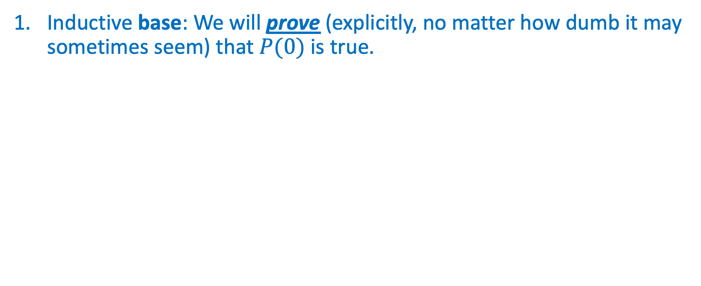
How we’ll make it work
Inductive base: We will prove (explicitly, no matter how dumb it may sometimes seem) that $P(0)$ is true.
0
$$1$$
$$2$$
$$…$$
$$…$$
$$n$$
$$n+1$$
$$…$$
$$…$$
$$…$$

Slide 28
How we’ll make it work
Inductive base: We will prove (explicitly, no matter how dumb it may sometimes seem) that $P(0)$ is true.
$$0$$
$$1$$
$$2$$
$$…$$
$$…$$
$$n$$
$$n+1$$
$$…$$
$$…$$
$$…$$

Slide 29
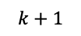
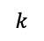
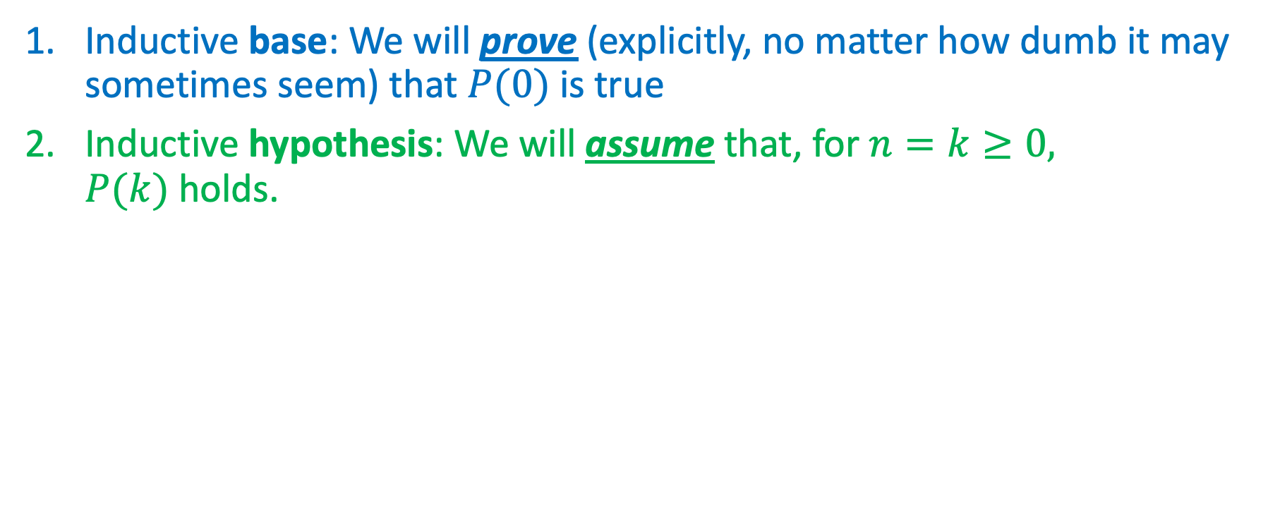

How we’ll make it work
Inductive base: We will prove (explicitly, no matter how dumb it may sometimes seem) that $P(0)$ is true
Inductive hypothesis: We will assume that, for $n=k≥0,$ $P(k)$holds.
Any $k$ at least $0$
$$0$$
$$1$$
$$2$$
$$…$$
$$…$$
$$k$$
$$k+1$$
$$…$$
$$…$$
$$…$$

Slide 30
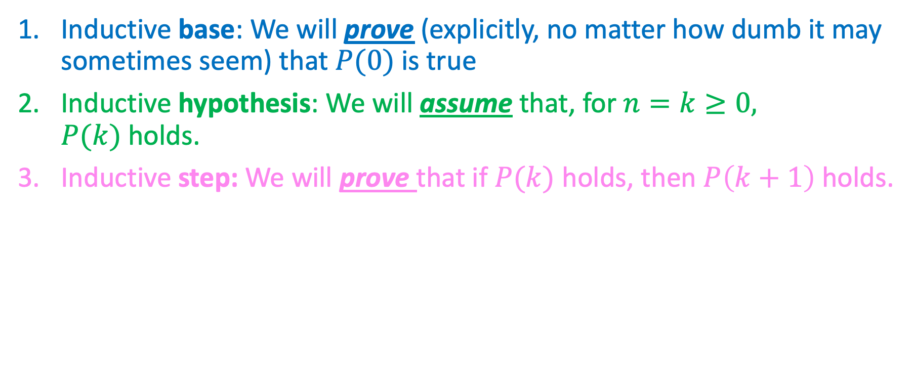
How we’ll make it work
Inductive base: We will prove (explicitly, no matter how dumb it may sometimes seem) that $P(0)$ is true
Inductive hypothesis: We will assume that, for $n=k≥0,$ $P(k)$holds.
Inductive step: We will prove that if $P(k)$ holds, then $P\left(k+1\right)$ holds.
Any $k$ at least $0$
$$0$$
$$1$$
$$2$$
$$…$$
$$…$$
$$k$$
$$k+1$$
$$…$$
$$…$$
$$…$$

Slide 31
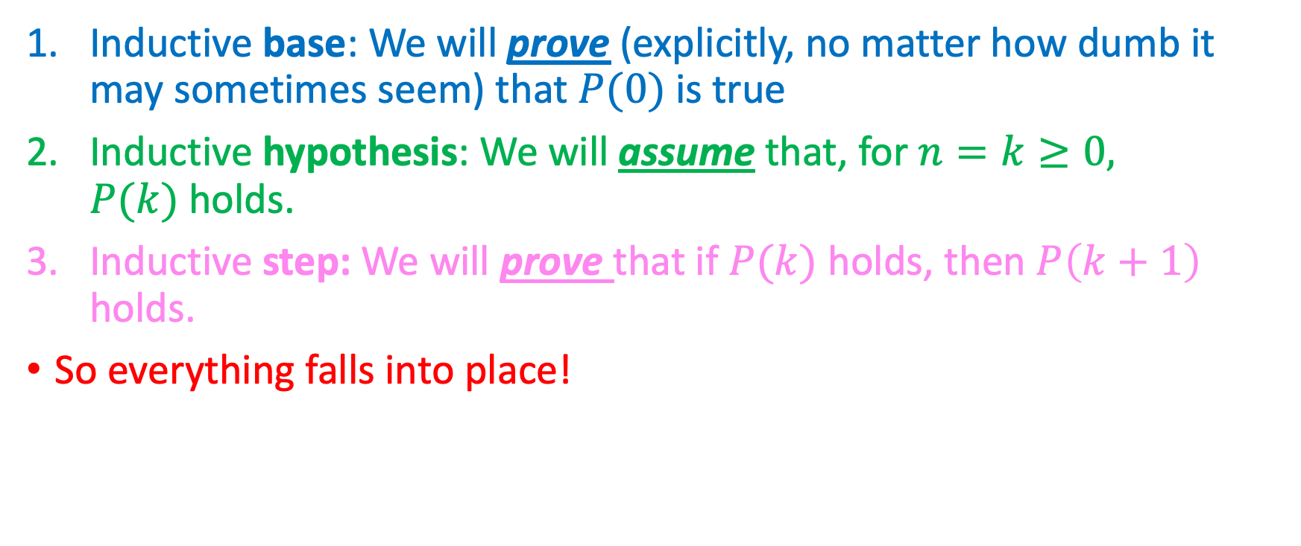
How we’ll make it work
Inductive base: We will prove (explicitly, no matter how dumb it may sometimes seem) that $P(0)$ is true
Inductive hypothesis: We will assume that, for $n=k≥0,$ $P(k)$holds.
Inductive step: We will prove that if $P(k)$ holds, then $P\left(k+1\right)$ holds.
So everything falls into place!
Any $k$ at least $0$
$$0$$
$$1$$
$$2$$
$$…$$
$$…$$
$$k$$
$$k+1$$
$$…$$
$$…$$
$$…$$

Slide 32
How we’ll make it work
Inductive base: We will prove (explicitly, no matter how dumb it may sometimes seem) that $P(0)$ is true
Inductive hypothesis: We will assume that, for $n=k≥0,$ $P(k)$holds.
Inductive step: We will prove that if $P(k)$ holds, then $P\left(k+1\right)$ holds.
So everything falls into place!
Any $k$ at least $0$
$$0$$
$$1$$
$$2$$
$$…$$
$$…$$
$$k$$
$$k+1$$
$$…$$
$$…$$
$$…$$

Slide 33
How we’ll make it work
Inductive base: We will prove (explicitly, no matter how dumb it may sometimes seem) that $P(0)$ is true
Inductive hypothesis: We will assume that, for $n=k≥0,$ $P(k)$holds.
Inductive step: We will prove that if $P(k)$ holds, then $P\left(k+1\right)$ holds.
So everything falls into place!
Any $k$ at least $0$
$$0$$
$$1$$
$$2$$
$$…$$
$$…$$
$$k$$
$$k+1$$
$$…$$
$$…$$
$$…$$

Slide 34
How we’ll make it work
Inductive base: We will prove (explicitly, no matter how dumb it may sometimes seem) that $P(0)$ is true
Inductive hypothesis: We will assume that, for $n=k≥0,$ $P(k)$holds.
Inductive step: We will prove that if $P(k)$ holds, then $P\left(k+1\right)$ holds.
So everything falls into place!
Any $k$ at least $0$
$$0$$
$$1$$
$$2$$
$$…$$
$$…$$
$$k$$
$$k+1$$
$$…$$
$$…$$
$$…$$

Slide 35
How we’ll make it work
Inductive base: We will prove (explicitly, no matter how dumb it may sometimes seem) that $P(0)$ is true
Inductive hypothesis: We will assume that, for $n=k≥0,$ $P(k)$holds.
Inductive step: We will prove that if $P(k)$ holds, then $P\left(k+1\right)$ holds.
So everything falls into place!
Any $k$ at least $0$
(We fast-forwarded here to save some time.)
$$0$$
$$1$$
$$2$$
$$…$$
$$…$$
$$k$$
$$k+1$$
$$…$$
$$…$$
$$…$$

Slide 36
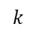

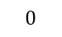
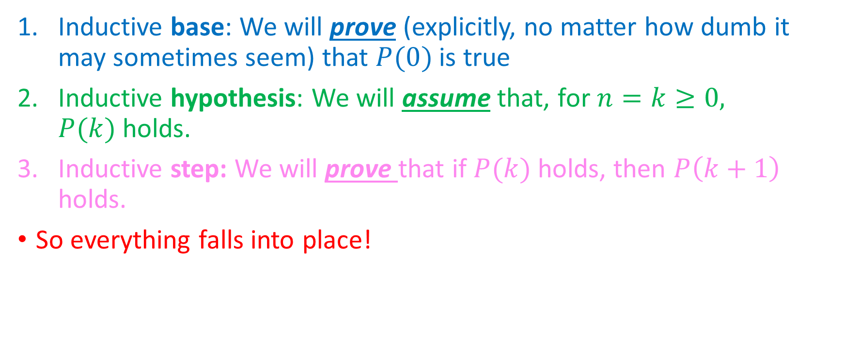

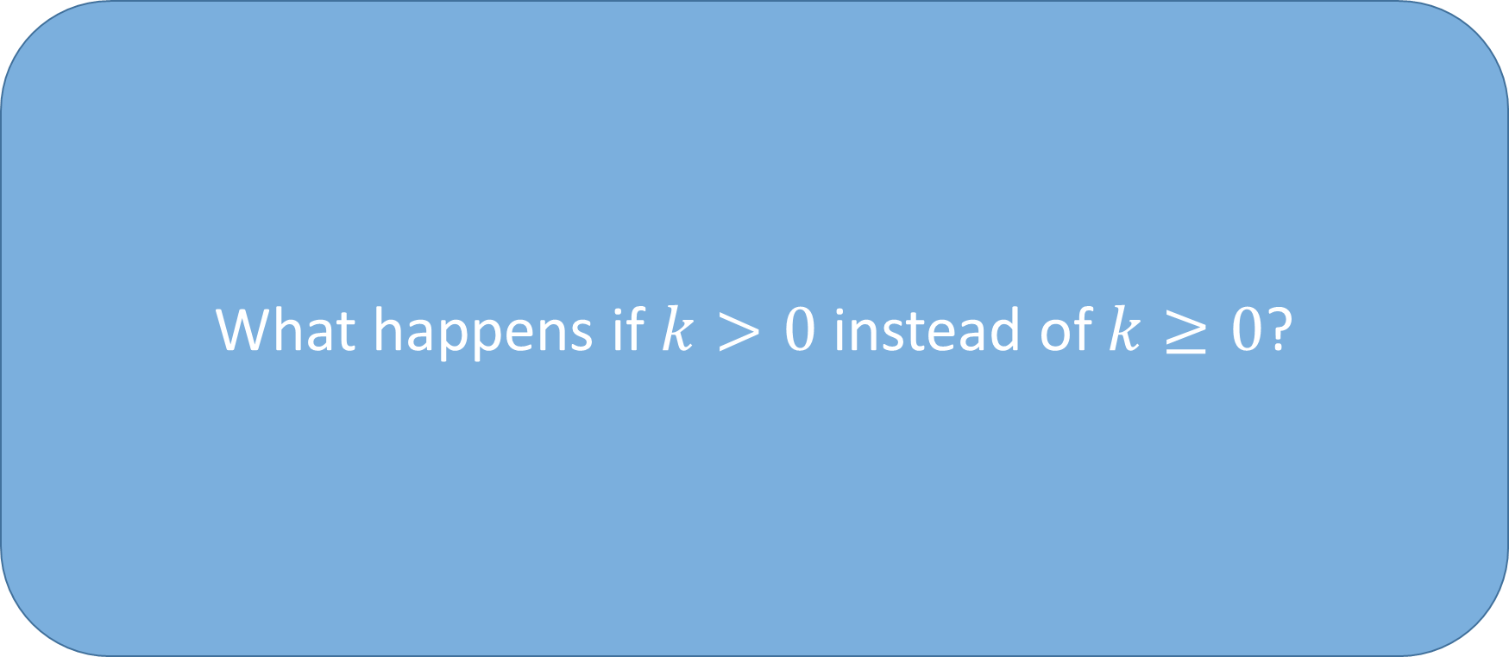

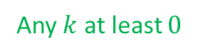

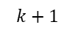
How we’ll make it work
What happens if $k>0$ instead of $k≥0$?
Inductive base: We will prove (explicitly, no matter how dumb it may sometimes seem) that $P(0)$ is true
Inductive hypothesis: We will assume that, for $n=k≥0,$ $P(k)$holds.
Inductive step: We will prove that if $P(k)$ holds, then $P\left(k+1\right)$ holds.
So everything falls into place!
Any $k$ at least $0$
(We fast-forwarded here to save some time.)
$$0$$
$$1$$
$$2$$
$$…$$
$$…$$
$$k$$
$$k+1$$
$$…$$
$$…$$
$$…$$

Slide 37
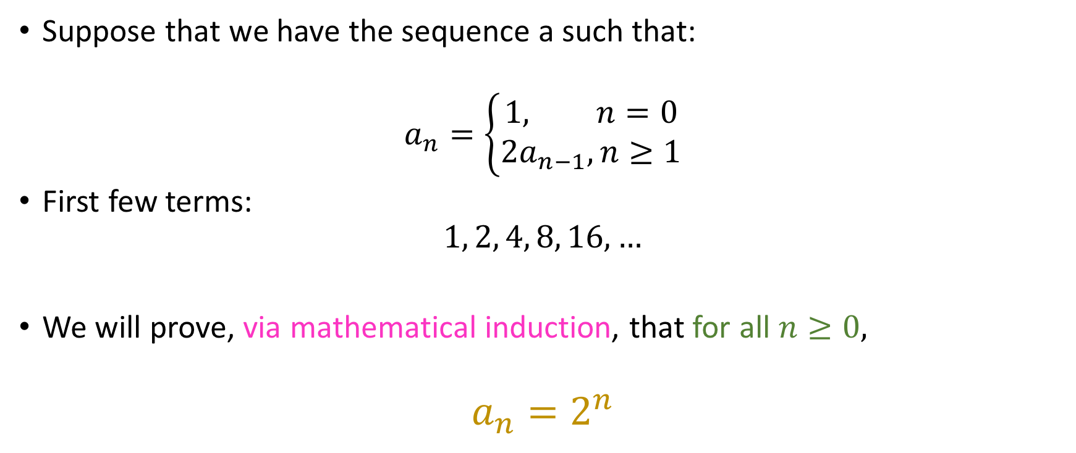
An introductory example
Suppose that we have the sequence a such that:
$$a_{n}=\left\{\begin{aligned}1, n=0 \\ 2a_{n−1}, n≥1\end{aligned}\right.$$
First few terms:
$$1, 2, 4, 8, 16, …$$
We will prove, via mathematical induction, that for all $n≥0,$
$$a_{n}=2^{n}$$

Slide 38
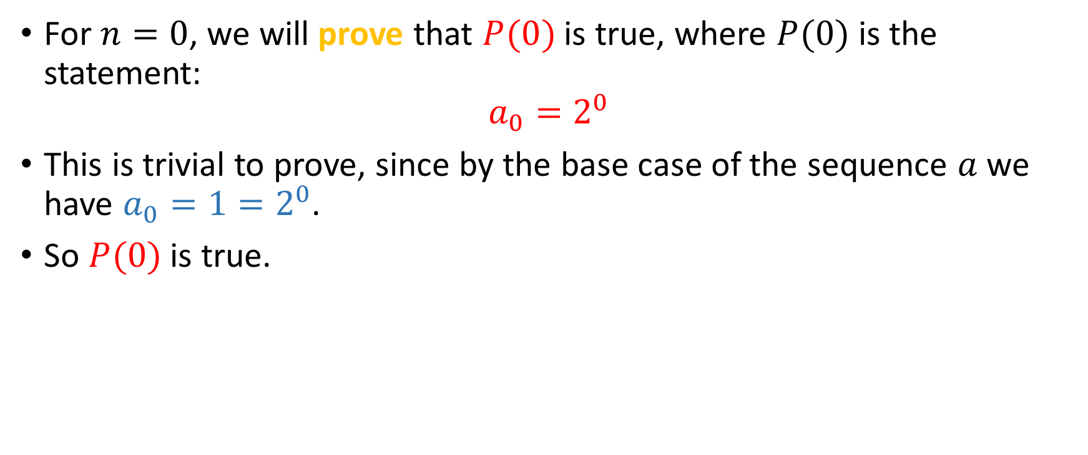
Inductive Base
For $n=0$, we will prove that $P(0)$ is true, where $P(0)$ is the statement:
$$a_{0}=2^{0}$$
This is trivial to prove, since by the base case of the sequence $a$ we have $a_{0}=1=2^{0}$.
So $P(0)$ is true.

Slide 39
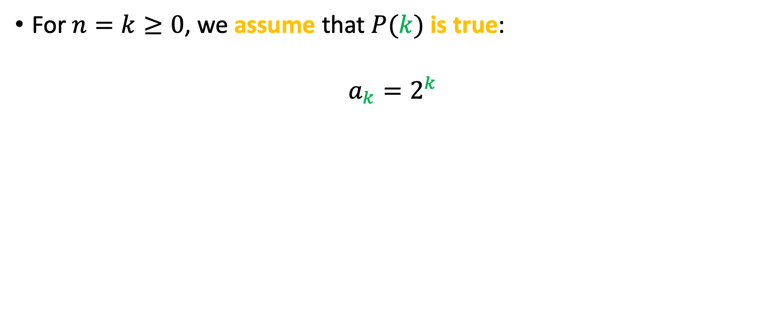
Inductive Hypothesis
For $n=k≥0$, we assume that $P(k)$is true:
$$a_{k}=2^{k}$$

Slide 40
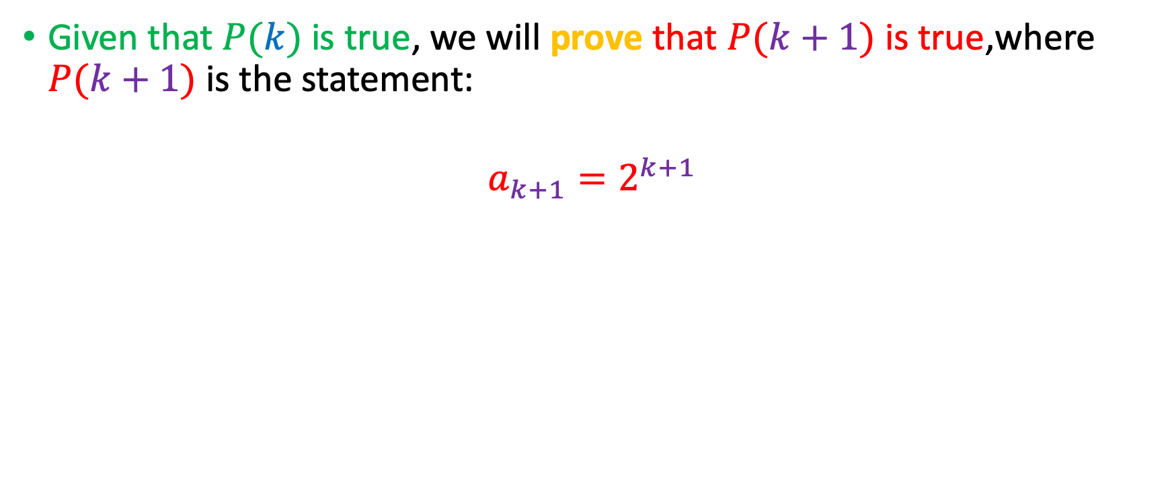
Inductive Step
Given that $P(k)$ is true, we will prove that $P(k+1)$ is true,where $P(k+1)$ is the statement:
$$a_{k+1}=2^{k+1}$$

Slide 41
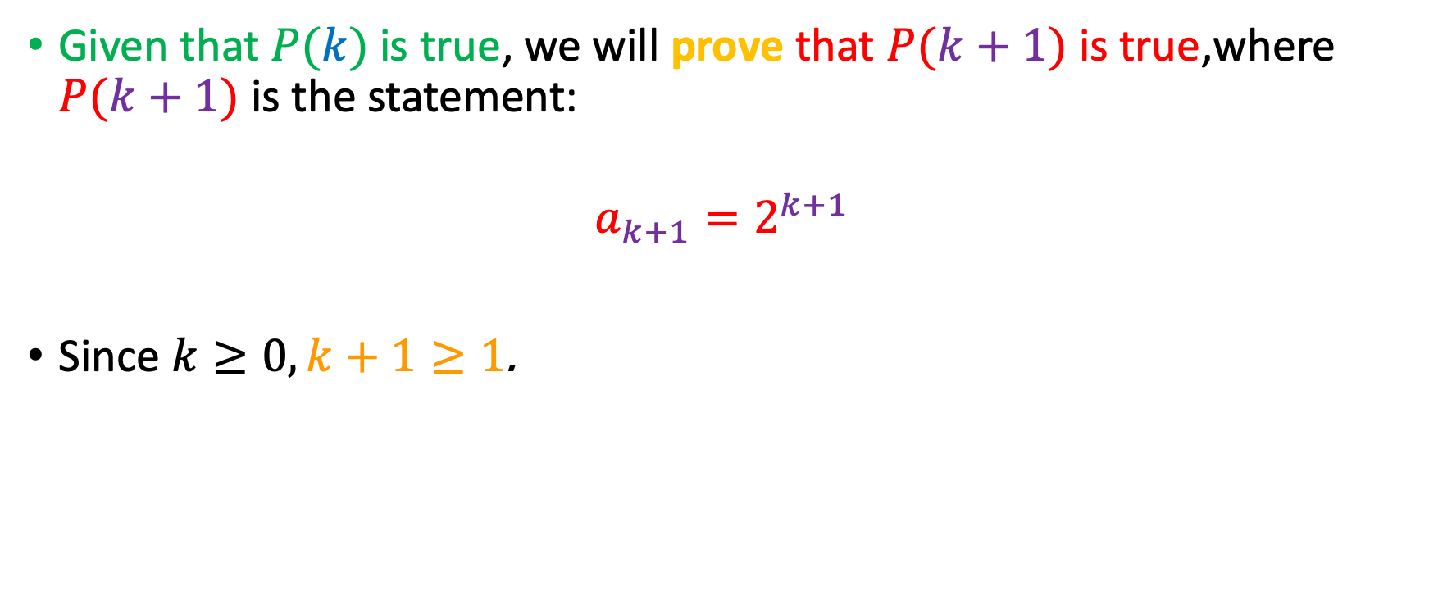
Inductive Step
Given that $P(k)$ is true, we will prove that $P(k+1)$ is true,where $P(k+1)$ is the statement:
$$a_{k+1}=2^{k+1}$$
Since $k≥0, k+1≥1$.

Slide 42
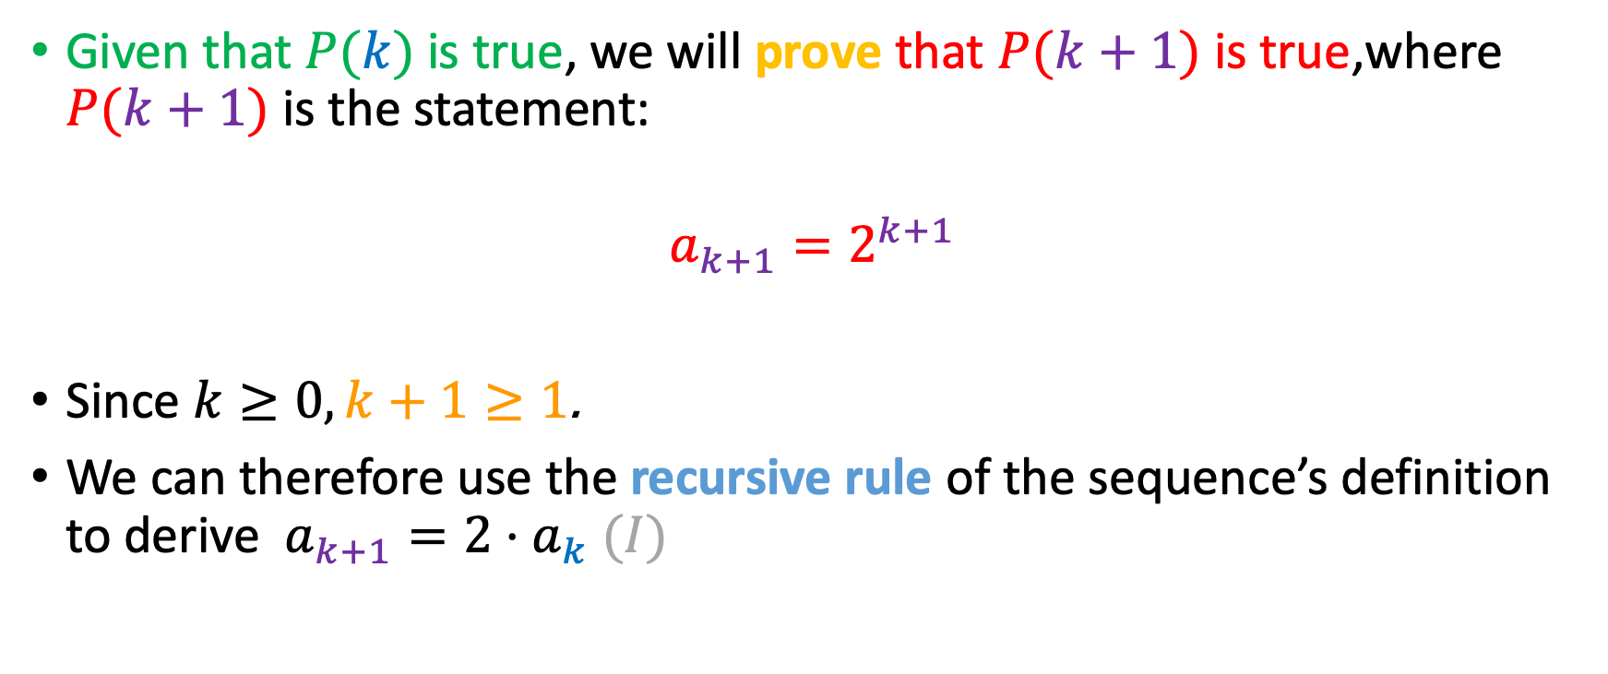
Inductive Step
Given that $P(k)$ is true, we will prove that $P(k+1)$ is true,where $P(k+1)$ is the statement:
$$a_{k+1}=2^{k+1}$$
Since $k≥0, k+1≥1$.
We can therefore use the recursive rule of the sequence’s definition to derive $a_{k+1}=2⋅a_{k}$ $(I)$

Slide 43
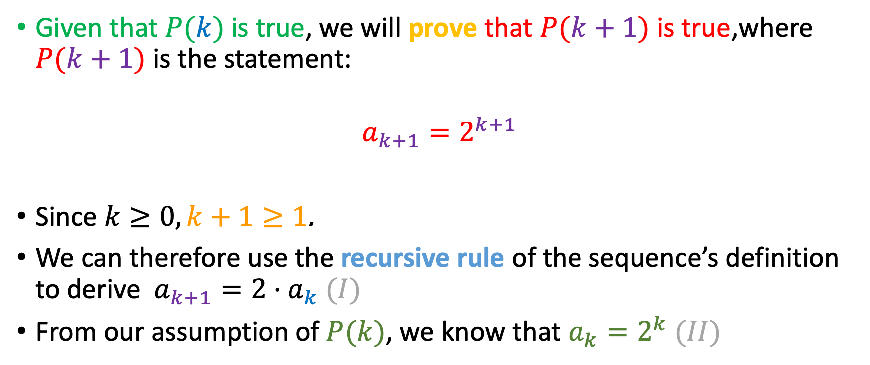
Inductive Step
Given that $P(k)$ is true, we will prove that $P(k+1)$ is true,where $P(k+1)$ is the statement:
$$a_{k+1}=2^{k+1}$$
Since $k≥0, k+1≥1$.
We can therefore use the recursive rule of the sequence’s definition to derive $a_{k+1}=2⋅a_{k}$ $(I)$
From our assumption of $P(k)$, we know that $a_{k}=2^{k}$ $(II)$

Slide 44
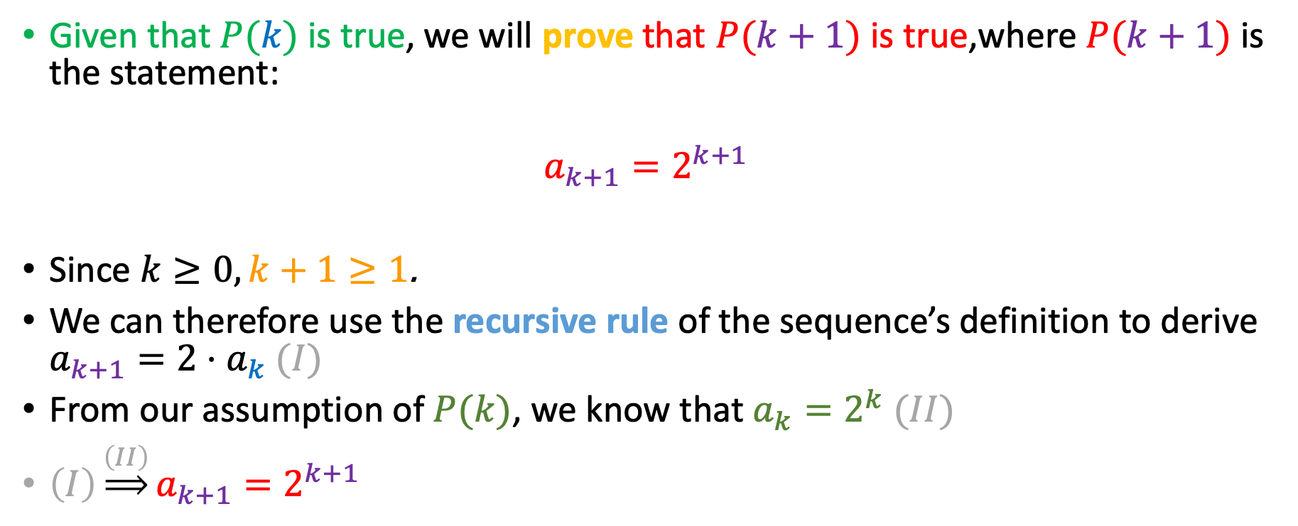
Inductive Step
Given that $P(k)$ is true, we will prove that $P(k+1)$ is true,where $P(k+1)$ is the statement:
$$a_{k+1}=2^{k+1}$$
Since $k≥0, k+1≥1$.
We can therefore use the recursive rule of the sequence’s definition to derive $a_{k+1}=2⋅a_{k}$ $(I)$
From our assumption of $P(k)$, we know that $a_{k}=2^{k}$ $(II)$
$\left(I\right)\underset{⇒}{\left(II\right)}a_{k+1}=2^{k+1}$

Slide 45
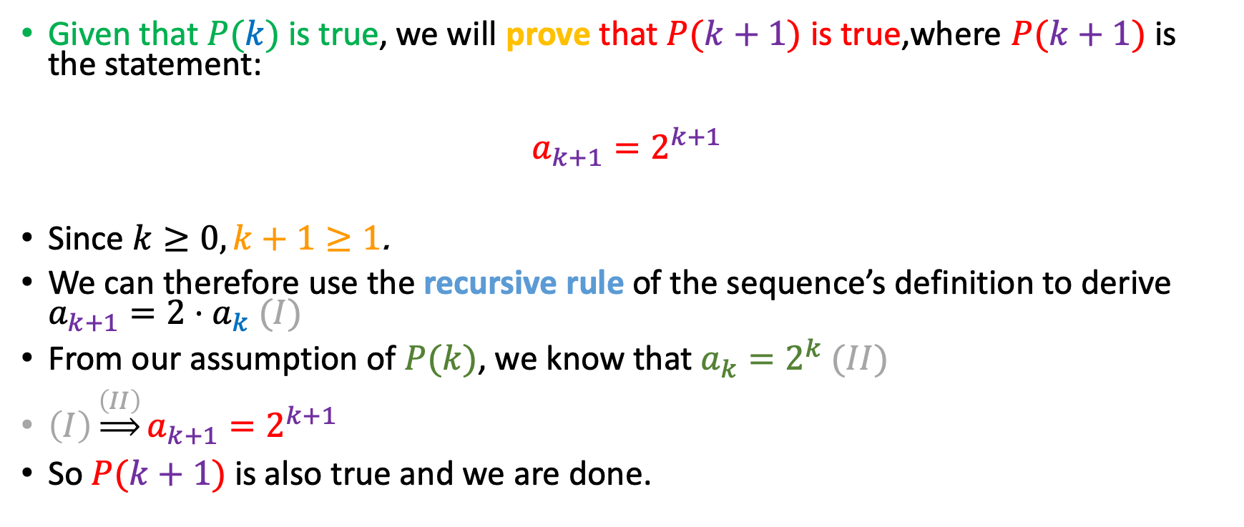
Inductive Step
Given that $P(k)$ is true, we will prove that $P(k+1)$ is true,where $P(k+1)$ is the statement:
$$a_{k+1}=2^{k+1}$$
Since $k≥0, k+1≥1$.
We can therefore use the recursive rule of the sequence’s definition to derive $a_{k+1}=2⋅a_{k}$ $(I)$
From our assumption of $P(k)$, we know that $a_{k}=2^{k}$ $(II)$
$\left(I\right)\underset{⇒}{\left(II\right)}a_{k+1}=2^{k+1}$
So $P(k+1)$ is also true and we are done.

Slide 46
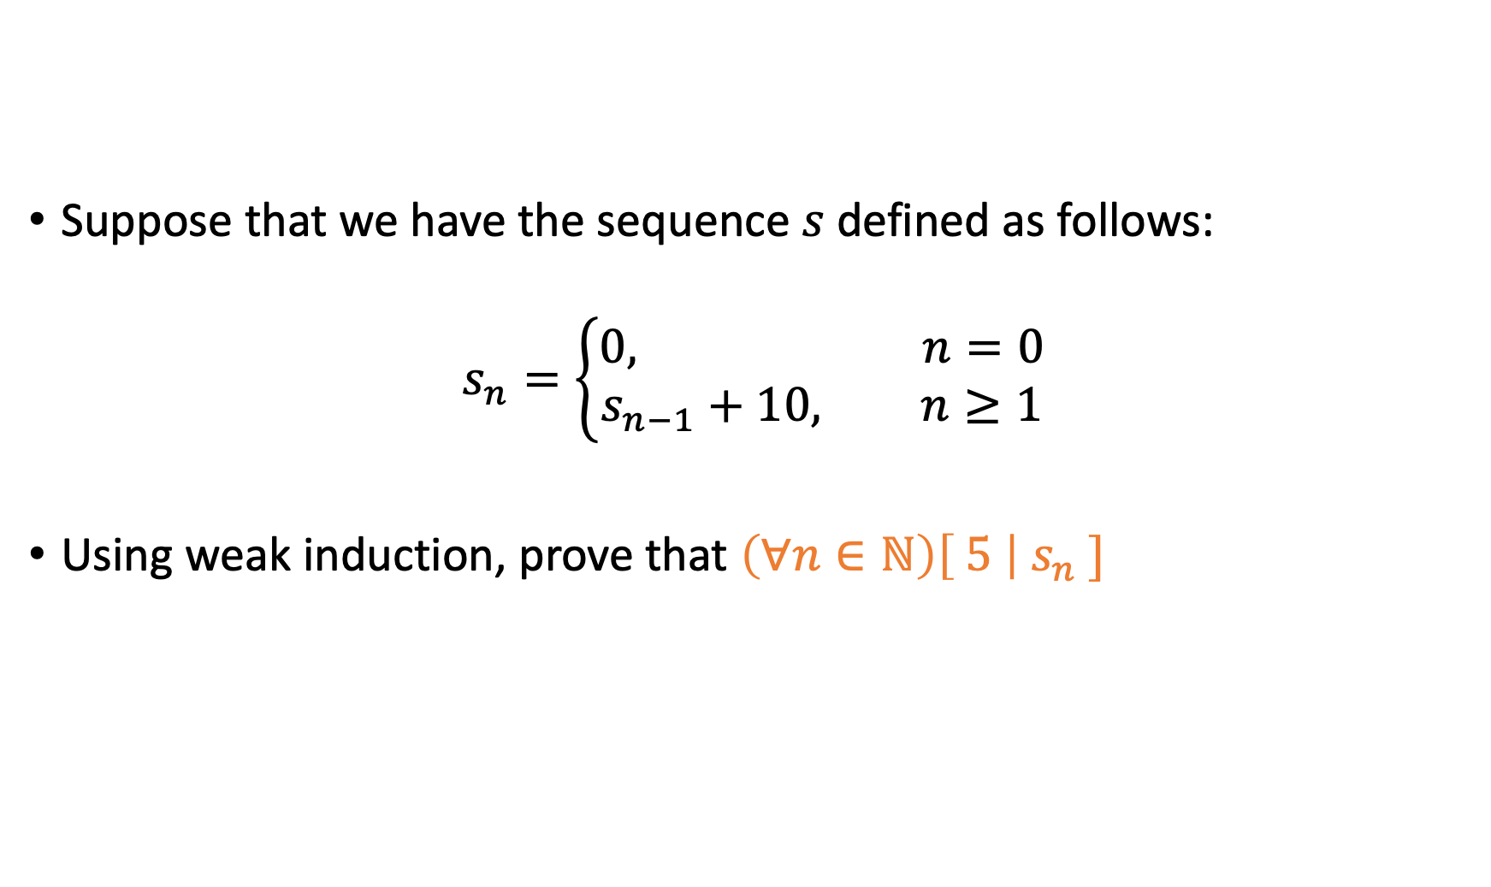
Here’s another
Suppose that we have the sequence $s$ defined as follows:
$$s_{n}=\left\{\begin{aligned}0, n=0 \\ s_{n−1}+10, n≥1\end{aligned}\right.$$
Using weak induction, prove that $\left(∀n∈ℕ\right)\left[ 5 \right|{ s}_{n} ]$

Slide 47
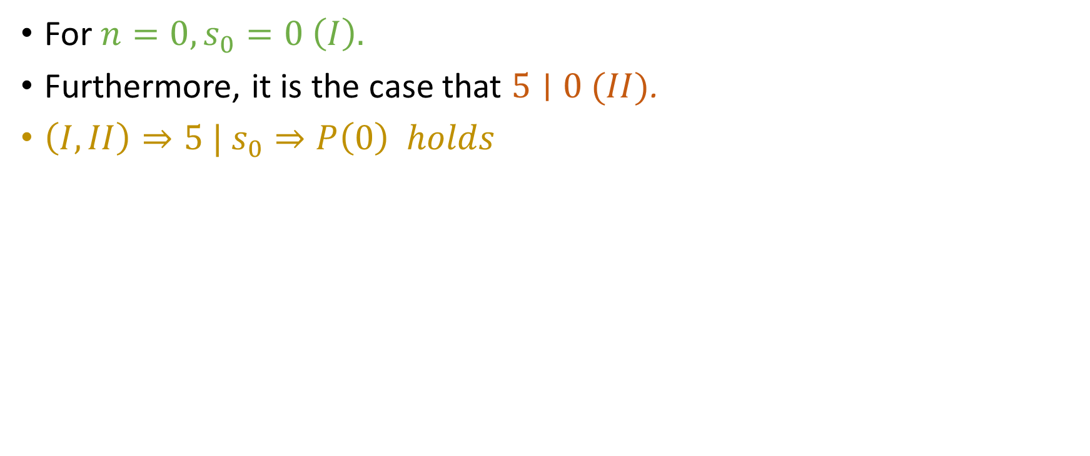
Inductive Base
For $n=0,s_{0}=0 \left(I\right).$
Furthermore, it is the case that $5∣0 (II)$.
$\left(I, II\right)⇒5 | s_{0}⇒P\left(0\right) holds$

Slide 48
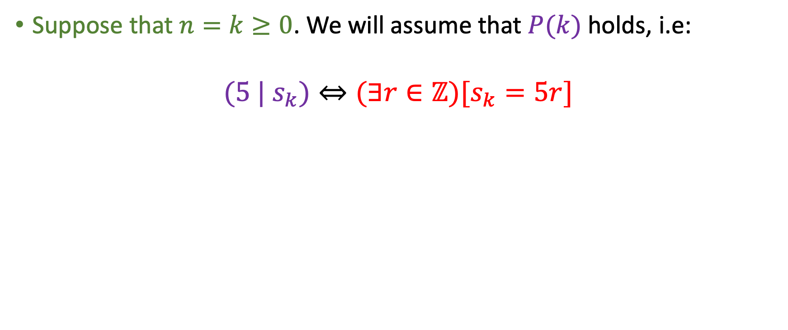
Inductive Hypothesis
Suppose that $n=k≥0$. We will assume that $P(k)$ holds, i.e:
$$(5 | s_{k})⇔(∃r∈ℤ)[s_{k}=5r]$$
Could also use the mod definition!

Slide 49
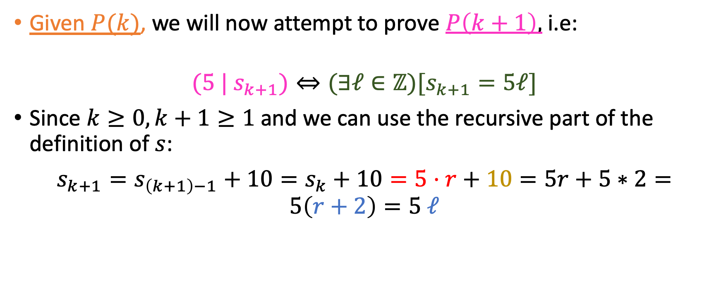
Inductive Step
Given $P(k)$, we will now attempt to prove $P\left(k+1\right),$ i.e:
$$(5 | s_{k+1})⇔(∃ℓ∈ℤ)[s_{k+1}=5ℓ]$$
Since $k≥0, k+1≥1$ and we can use the recursive part of the definition of $s$:
$s_{k+1}=s_{\left(k+1\right)−1}+10=s_{k}+10=5⋅r$ $+ 10=5r+5∗2=5\left(r+2\right)=5 ℓ$
(By I.H)

Slide 50
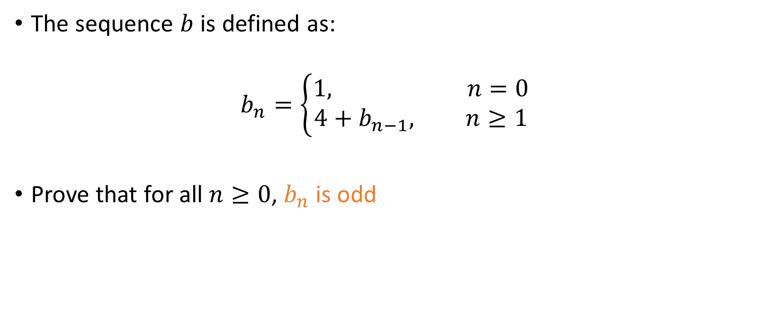
You do this!
The sequence $b$ is defined as:
$$b_{n}=\left\{\begin{aligned}1, n=0 \\ 4+b_{n−1}, n≥1\end{aligned}\right.$$
Prove that for all $n≥0$, $b_{n}$ is odd

Slide 51
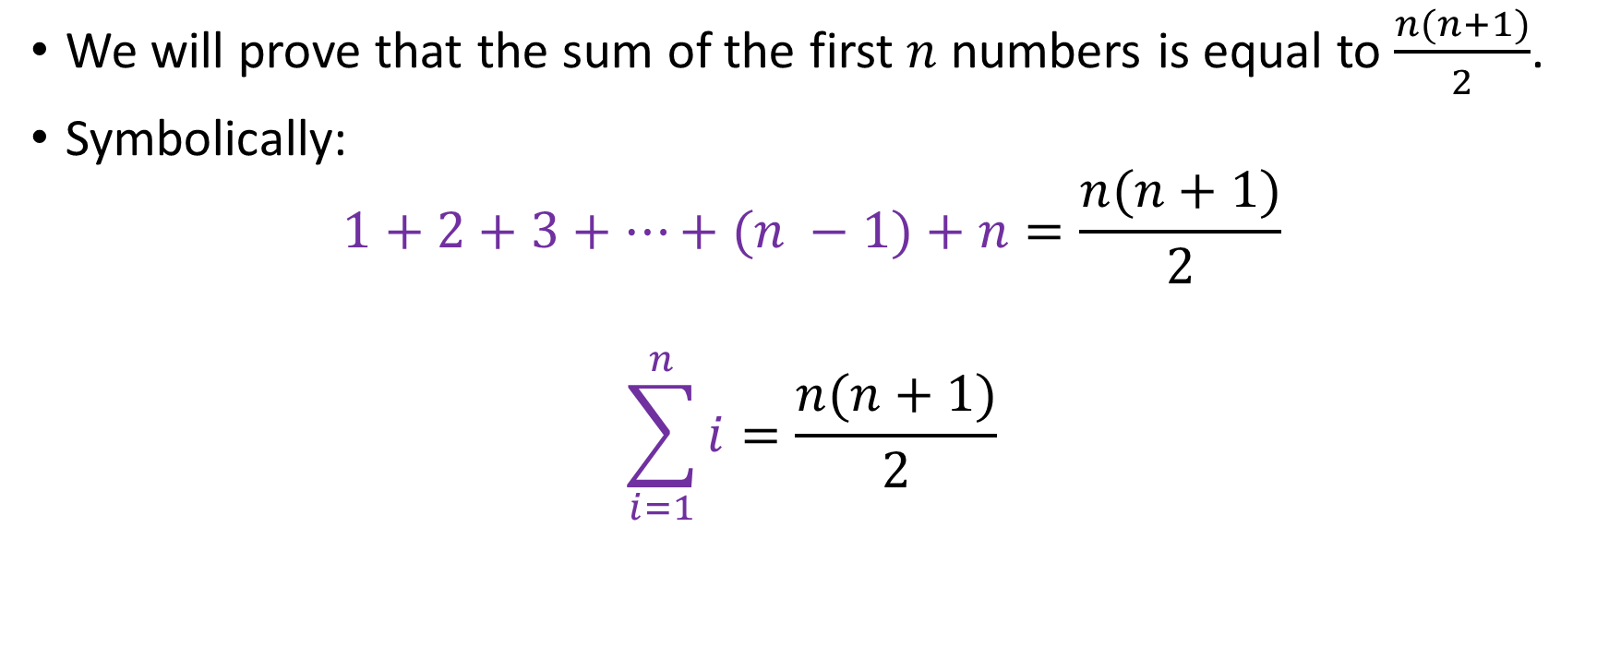
The Gaussian Sum
We will prove that the sum of the first $n$ numbers is equal to $\frac{n(n+1)}{2}$.
Symbolically:
$$1+2+3+…+(n −1)+n=\frac{n(n+1)}{2}$$
$$\sum_{i=1}^{n}{i}=\frac{n(n+1)}{2}$$

Slide 52
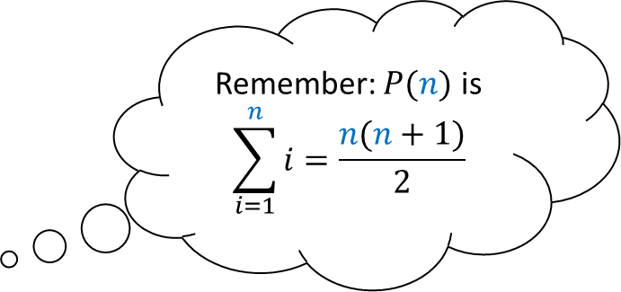
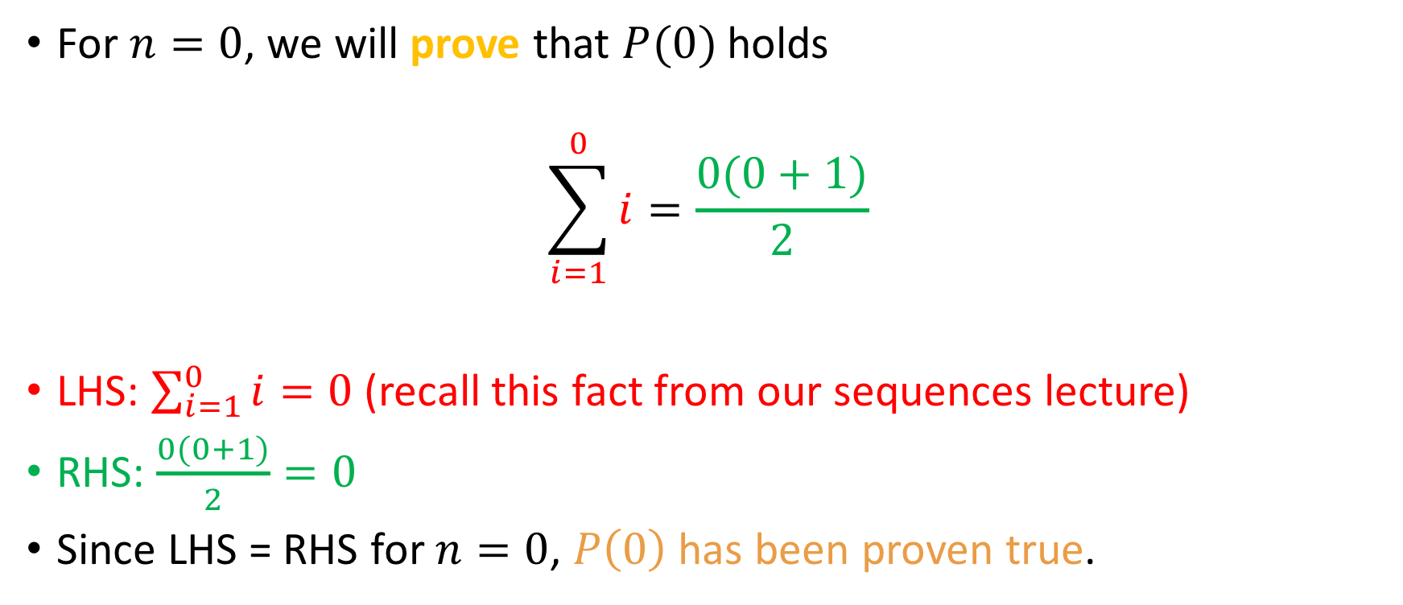
Inductive base
Remember: $P(n)$ is
$$\sum_{i=1}^{n}{i=\frac{n(n+1)}{2}}$$
For $n=0$, we will prove that $P(0)$ holds
$$\sum_{i=1}^{0}{i=\frac{0(0+1)}{2}}$$
LHS: $\sum_{i=1}^{0}{i}=0$ (recall this fact from our sequences lecture)
RHS: $\frac{0(0+1)}{2}=0$
Since LHS = RHS for $n=0$, $P\left(0\right)$has been proven true.
?

Slide 53
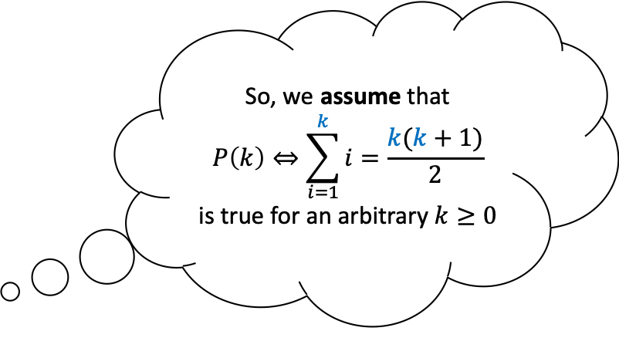
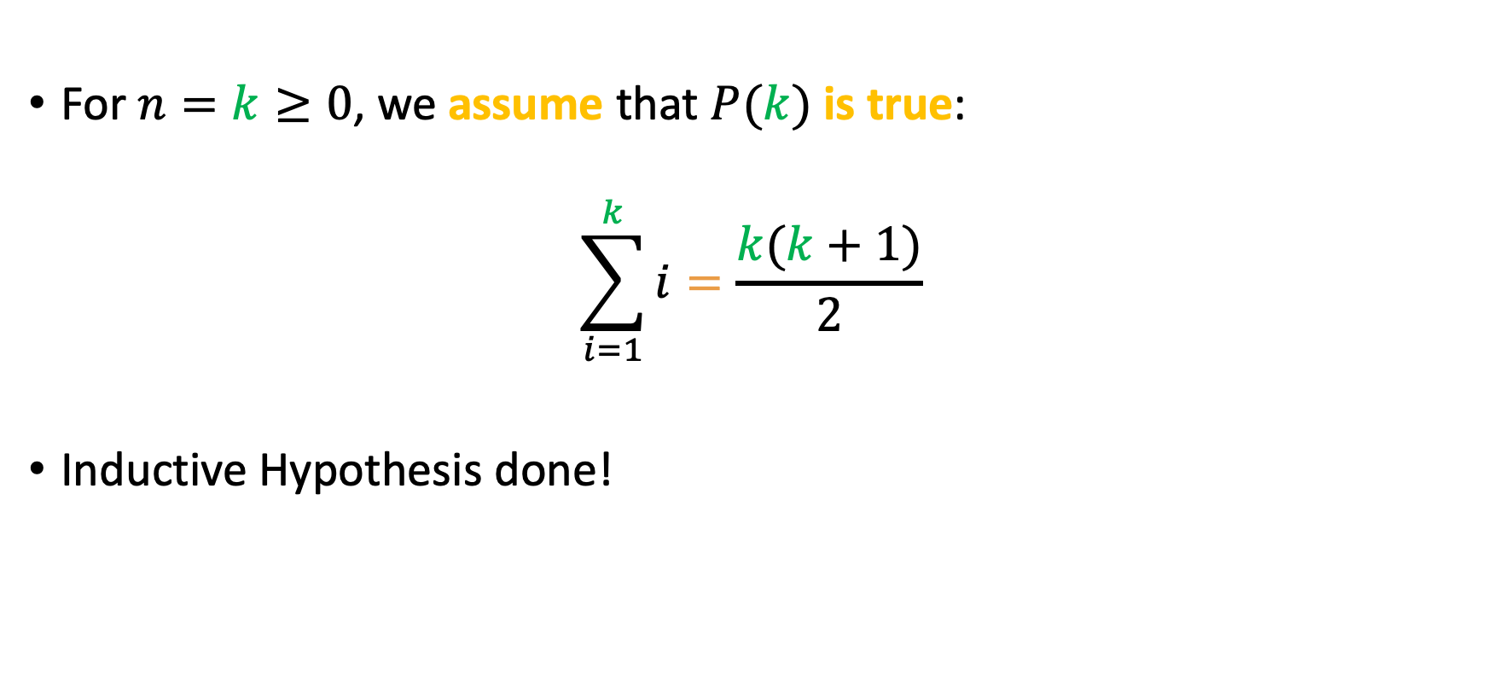
Inductive Hypothesis
So, we assume that
$$P\left(k\right)⇔\sum_{i=1}^{k}{i=\frac{k(k+1)}{2}}$$
is true for an arbitrary $k≥0$
For $n=k≥0$, we assume that $P(k)$is true:
$$\sum_{i=1}^{k}{i}=\frac{k(k+1)}{2}$$
Inductive Hypothesis done!

Slide 54
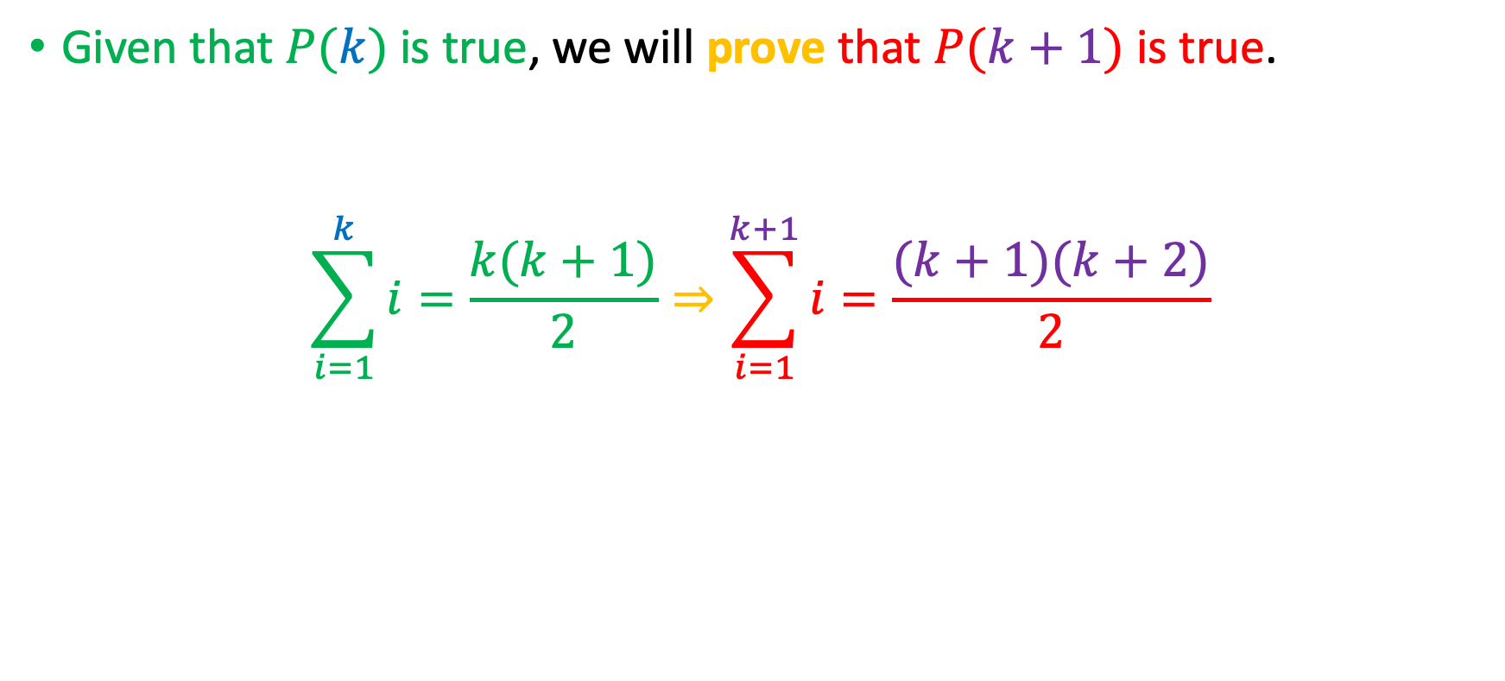
Inductive step
Given that $P(k)$ is true, we will prove that $P(k+1)$ is true.
$$\sum_{i=1}^{k}{i=\frac{k(k+1)}{2}}⇒\sum_{i=1}^{k+1}{i=\frac{(k+1)(k+2)}{2}}$$

Slide 55


Inductive step
Given that $P(k)$ is true, we will prove that $P(k+1)$ is true.
$$\sum_{i=1}^{k}{i=\frac{k(k+1)}{2}}⇒\sum_{i=1}^{k+1}{i=\frac{(k+1)(k+2)}{2}}$$
Just adding 1 to $k$
Just adding 1 to $k+1$

Slide 56
Inductive step
Given that $P(k)$ is true, we will prove that $P(k+1)$ is true.
$$\sum_{i=1}^{k}{i=\frac{k(k+1)}{2}}⇒\sum_{i=1}^{k+1}{i=\frac{(k+1)(k+2)}{2}}$$
Just adding 1 to $k$
Just adding 1 to $k+1$
This is our goal!

Slide 57
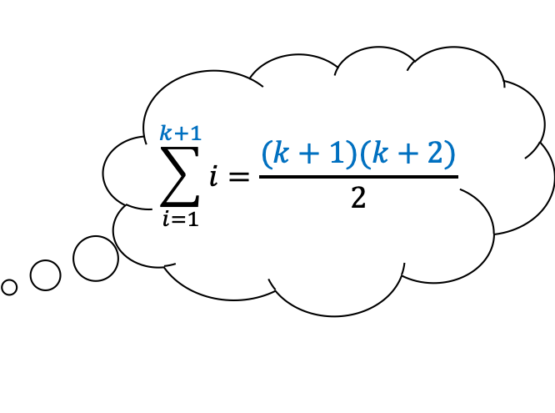
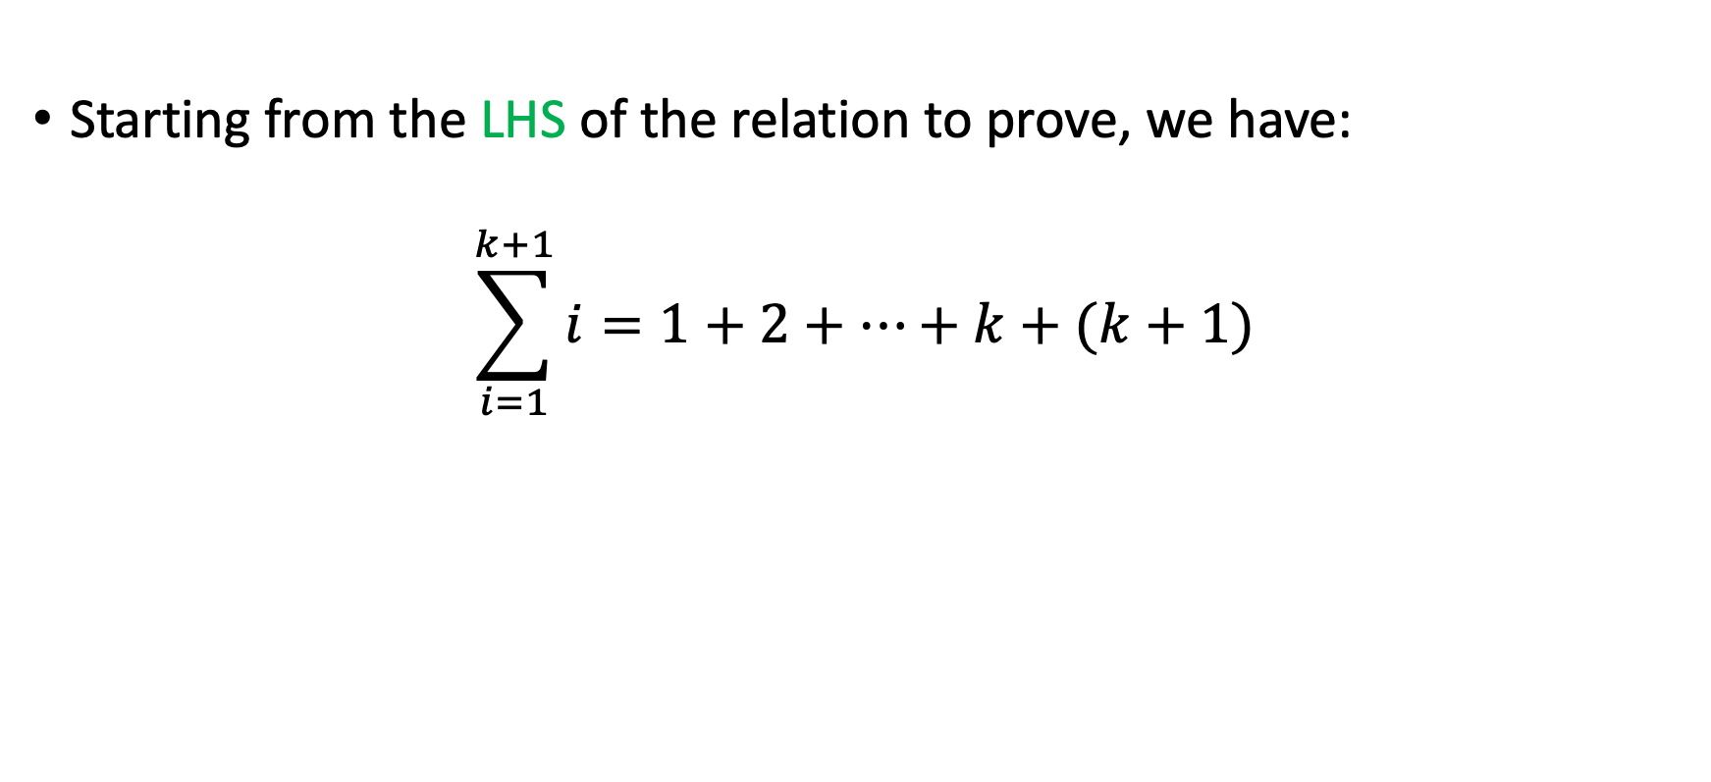
Inductive step, contd.
$$\sum_{i=1}^{k+1}{i=\frac{(k+1)(k+2)}{2}}$$
Starting from the LHS of the relation to prove, we have:
$$\sum_{i=1}^{k+1}{i}=1+2+…+k+(k+1)$$

Slide 58
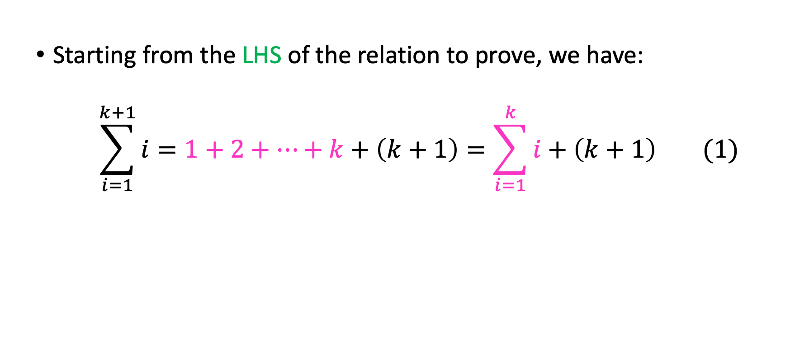
Inductive step, contd.
$$\sum_{i=1}^{k+1}{i=\frac{(k+1)(k+2)}{2}}$$
Starting from the LHS of the relation to prove, we have:
$$\sum_{i=1}^{k+1}{i}=1+2+…+k+\left(k+1\right)=\sum_{i=1}^{k}{i}+\left(k+1\right) (1)$$

Slide 59

Inductive step, contd.
$$\sum_{i=1}^{k+1}{i=\frac{(k+1)(k+2)}{2}}$$
Starting from the LHS of the relation to prove, we have:
$$\sum_{i=1}^{k+1}{i}=1+2+…+k+\left(k+1\right)=\sum_{i=1}^{k}{i}+\left(k+1\right) (1)$$
From the Inductive Hypothesis, we have that
$$\sum_{i=1}^{k}{i=}\frac{k(k+1)}{2} (2)$$

Slide 60
Inductive step, contd.
$$\sum_{i=1}^{k+1}{i=\frac{(k+1)(k+2)}{2}}$$
Starting from the LHS of the relation to prove, we have:
$$\sum_{i=1}^{k+1}{i}=1+2+…+k+\left(k+1\right)=\sum_{i=1}^{k}{i}+\left(k+1\right) (1)$$
From the Inductive Hypothesis, we have that
$$\sum_{i=1}^{k}{i=}\frac{k(k+1)}{2} (2)$$

Slide 61

Inductive step, contd.
$$\sum_{i=1}^{k+1}{i=\frac{(k+1)(k+2)}{2}}$$
Starting from the LHS of the relation to prove, we have:
$$\sum_{i=1}^{k+1}{i}=1+2+…+k+\left(k+1\right)=\sum_{i=1}^{k}{i}+\left(k+1\right)(1)$$
From the Inductive Hypothesis, we have that
$$\sum_{i=1}^{k}{i=}\frac{k(k+1)}{2} (2)$$
Substituting (2) into (1) yields (next slide):

Slide 62

Inductive step, contd.
$$\sum_{i=1}^{k+1}{i}=\frac{k(k+1)}{2}+\left(k+1\right)=\frac{k(k+1)}{2}+\frac{2(k+1)}{2}=\frac{(k+2)(k+1)}{2}$$ $=RHS$

Slide 63

Inductive step, contd.
$$\sum_{i=1}^{k+1}{i}=\frac{k(k+1)}{2}+\left(k+1\right)=\frac{k(k+1)}{2}+\frac{2(k+1)}{2}=\frac{(k+2)(k+1)}{2}$$ $=RHS$
So, when $P\left(k\right)$ is true, $P(k+1)$ was also proven true.
We conclude that $P(n)$ is true $∀n≥0. □$

Slide 64


And one for you!
$$\sum_{i=0}^{n}{i^{2}}=\frac{n(n+1)(2n+1)}{6}$$

Slide 65

Inductive Base
For $n=0$, LHS = $\sum_{i=1}^{0}{i^{2}}=0$
RHS=$\frac{0(0+1)(2∗0+1)}{2}=0$
Since LHS = RHS, $P(0)$ holds and we are done.

Slide 66

Inductive Base
For $n=0$, LHS = $\sum_{i=1}^{0}{i^{2}}=0$
RHS=$\frac{0(0+1)(2∗0+1)}{2}=0$
Since LHS = RHS, $P(0)$ holds and we are done.
You could also start from $n=1$! LHS = RHS in both cases
$n=0$ sometimes makes the math easier (RHS in this case)

Slide 67

Inductive Hypothesis
Suppose that $n=k≥0$. (Or 1 in the alternative scenario)
We will then assume $P(k)$, i.e:
$$\sum_{i=1}^{k}{i^{2}}=\frac{k(k+1)(2k+1)}{6}$$

Slide 68

Inductive Step
Careful with factoring please!!!
We will now attempt to prove $P(k+1)$, i.e
$$\sum_{i=1}^{k+1}{i^{2}}=\frac{(k+1)(k+2)(2k+3)}{6}$$

Slide 69

Inductive Step
Careful with factoring please!!!
We will now attempt to prove $P(k+1)$, i.e
$$\sum_{i=1}^{k+1}{i^{2}}=\frac{(k+1)(k+2)(2k+3)}{6}$$
By leveraging associativity of sum, the LHS can be written as follows:
$$\sum_{i=1}^{k+1}{i^{2}}=\sum_{i=1}^{k}{i^{2}+{\left(k+1\right)}^{2}}$$

Slide 70
Inductive Step
Careful with factoring please!!!
We will now attempt to prove $P(k+1)$, i.e
$$\sum_{i=1}^{k+1}{i^{2}}=\frac{(k+1)(k+2)(2k+3)}{6}$$
By leveraging associativity of sum, the LHS can be written as follows:
$$\sum_{i=1}^{k+1}{i^{2}}=\sum_{i=1}^{k}{i^{2}+{\left(k+1\right)}^{2}}$$
We can apply the I.H here!

Slide 71

Inductive Step
By I.H, we can now write:
$$\sum_{i=1}^{k+1}{i^{2}}=\frac{k(k+1)(2k+1)}{6}+{\left(k+1\right)}^{2}$$
Remember: we want this to be equal to
$\frac{(k+1)(k+2)(2k+3)}{6}$
We will fearlessly manipulate the algebra until it does!

Slide 72

Inductive Step - Algebra
$$\frac{k(k+1)(2k+1)}{6}+{\left(k+1\right)}^{2}=\frac{k(k+1)(2k+1)}{6}+\frac{6{\left(k+1\right)}^{2}}{6}= \\ =\frac{\left(k+1\right)[k\left(2k+1\right)+6(k+1)]}{6}=\frac{\left(k+1\right)[2k^{2}+7k+ 6]}{6}$$
If only we could prove that $2k^{2}+7k+ 6=$ $(k+2)(2k+3)$, we’d be done!
But…. $\left(k+2\right)\left(2k+3\right)=2k^{2}+3k+4k+6=$ $2k^{2}+7k+ 6$! ☺
So we’re done.

Slide 73

And one with more than 1 variable!
Prove that the sum of the first $n$ terms of a geometric sequence with $m∈(ℝ−\left\{1\right\})$ and $a_{0}=1$ is equal to $\frac{m^{n} −1}{m −1}.$
Symbolically:
$$\sum_{i=0}^{n−1}{m^{i}=}\frac{m^{n} −1}{m −1}$$

Slide 74

And one with more than 1 variable!
Prove that the sum of the first $n$ terms of a geometric sequence with $m∈(ℝ−\left\{1\right\})$ and $a_{0}=1$ is equal to $\frac{m^{n} −1}{m −1}.$
Symbolically:
$$\sum_{i=0}^{n−1}{m^{i}=}\frac{m^{n} −1}{m −1}$$
In this instance, we have two variables, $m$ and $n$, and it’s spectacularly easy to confuse ourselves about which variable we will be focusing on.
So, we will explicitly say, at the beginning of our proof, that we will be performing a proof by induction on $n$.

Slide 75

Proof
Proof : We attempt to prove $P\left(n\right), ∀n∈ℕ^{ }$. We proceed via induction on $n.$
Inductive base: We attempt to prove $P\left(0\right).$
$P\left(0\right):$ $\sum_{i=0}^{0−1}{m^{i}=}\frac{m^{0} −1}{m −1}⇔\sum_{i=0}^{−1}{m^{i}=}\frac{m^{0} −1}{m −1}⇔0=0$
So $P(0)$ is true.
Inductive hypothesis: Suppose $n=k≥0.$We assume $P\left(k\right),$ i.e
$$\sum_{i=0}^{k−1}{m^{i}=\frac{m^{k} −1}{m −1}}$$

Slide 76


Proof (contd.)
Inductive step: We will attempt to prove $P\left(k+1\right),$ i.e
$$\sum_{i=0}^{k}{m^{i}=\frac{m^{k+1} −1}{m −1}}$$
From the LHS to the RHS:
$$LHS= \sum_{i=0}^{k}{m^{i}=\sum_{i=0}^{k−1}{m^{i}+m^{k}=\frac{m^{k}−1 }{m−1}+m^{k}=\frac{m−1 +m^{k}(m−1) }{m−1}=}}\frac{m^{k+1}−1}{m−1}\text{=} \text{RHS} □$$
$$\left(k+1\right)−1$$
By the I.H

Slide 77


A coin problem
We will prove that every dollar amount $≥4$ cents can be exclusively paid for by 2 and/or 5 cent coins.

Slide 78


Theorem expressed in quantifiers
All quantifiers implicitly assumed over $ℕ$.
$$\left(∀n≥4\right)\left(∃n_{1},n_{2}\right)[n=2n_{1}+5n_{2}]$$

Slide 79

Inductive base
The least amount of money we are required to prove the statement for is 4¢, so we will attempt to prove $P(4)$.
For $n=4$, we have 4¢. Since $\text{4¢}=2×2\text{¢}$, we are done (we have shown that the amount of 4¢ can be exclusively paid for by using only 2 and/or 5 cent coins)

Slide 80

Inductive hypothesis
Let $n=k≥4.$
Assume $P\left(k\right)⇔\left(∃k_{1},k_{2}\right)[k=2k_{1}+5k_{2}]$

Slide 81

Inductive step
We will prove that $P\left(k\right)⇒P\left(k+1\right),$ i.e that we can pay an amount of money equal to $k+1$ cents using only 2¢ or 5¢ coins.
In terms of algebra, what we want to prove is:
$$(∃k_{3},k_{4}∈{ℕ)}^{ }[k+1=2k_{3}+5k_{4}]$$

Slide 82
Inductive step
We will prove that $P\left(k\right)⇒P\left(k+1\right),$ i.e that we can pay an amount of money equal to $k+1$ cents using only 2¢ or 5¢ coins.
In terms of algebra, what we want to prove is:
$$(∃k_{3},k_{4}∈{ℕ)}^{ }[k+1=2k_{3}+5k_{4}]$$
Different variables from I.H!

Slide 83

Inductive Step (contd.)
From the Inductive Hypothesis (I.H), we have that for some specific positive integers $k_{1}$ and $k_{2}$:
$$k=2k_{1}+5k_{2}$$

Slide 84

Inductive Step (contd.)
From the Inductive Hypothesis (I.H), we have that for some specific positive integers $k_{1}$ and $k_{2}$:
$$k=2k_{1}+5k_{2}$$
Case #1: $k_{1}≥2$
I have at least 2 2¢ coins, so I can take away 2 2¢ coins and add one
5¢ coin

Slide 85



Inductive Step (contd.)
From the Inductive Hypothesis (I.H), we have that for some specific positive integers $k_{1}$ and $k_{2}$:
$$k=2k_{1}+5k_{2}$$
Case #1: $k_{1}≥2$
I have at least 2 2¢ coins, so I can take away two 2¢ coins and add one 5 ¢ coin
By adding 1 on both sides of the I.H we obtain:
$$k+1=2k_{1}+5k_{2}+1=2k_{1}+5k_{2}+\left(5 −2∗2\right)=$$
$$\text{=}\left(2k_{1}−4\right)+\left(5k_{2}+5\right)=2\underbrace{{(k}_{1}−2)}+5\underbrace{(k_{2}+1)}=2k_{3}+5k_{4}$$
$$k_{3}$$
$$k_{4}$$

Slide 86



Inductive Step (contd.)
From the Inductive Hypothesis (I.H), we have that for some specific positive integers $k_{1}$ and $k_{2}$:
$$k=2k_{1}+5k_{2}$$
Case #1: $k_{1}≥2$
I have at least 2 2¢ coins, so I can take away two 2¢ coins and add one 5 ¢ coin
By adding 1 on both sides of the I.H we obtain:
$$k+1=2k_{1}+5k_{2}+1=2k_{1}+5k_{2}+\left(5 −2∗2\right)=$$
$$\text{=}\left(2k_{1}−4\right)+\left(5k_{2}+5\right)=2\underbrace{{(k}_{1}−2)}+5\underbrace{(k_{2}+1)}=2k_{3}+5k_{4}$$
$k_{1}−2≥0$ because $$k_{1}≥2$$
In $ℕ$ by closure

Slide 87



Inductive step
Case #2: $k_{2}≥1$
I have at least one 5¢ coin so I can take away one 5¢ coin and add three 2¢ coins
By adding 1 on both sides of the I.H we obtain:
$$k+1=2k_{1}+5k_{2}+1=2k_{1}+5k_{2}+\left(3∗2−5\right)=$$
$=2\underbrace{{(k}_{1}+3)} +5\underbrace{(k_{2}−1)}=2k_{3}+5k_{4}$
$$k_{3}$$
$$k_{4}$$

Slide 88



Inductive step
Case #2: $k_{2}≥1$
I have at least one 5¢ coin so I can take away one 5¢ coin and add three 2¢ coins
By adding 1 on both sides of the I.H we obtain:
$$k+1=2k_{1}+5k_{2}+1=2k_{1}+5k_{2}+\left(3∗2−5\right)=$$
$=2\underbrace{(k_{1}+3)} +5\underbrace{(k_{2}−1)}=2k_{3}+5k_{4}$
$(k_{1}+3)∈ℕ$ by closure
$$k_{2}−1≥0$$
because
$$k_{2}≥1$$

Slide 89

Inductive step
Case #3: ${(k}_{1}≤1)∧(k_{2}=0)$
This case means that we have either 0 or 2¢ at our disposal.
But this is not possible, since we want to prove the theorem only for values $≥4\text{¢}$
So we’re done. $□$

Slide 90

A note about the penny problem
Note that we proved the theorem for $n≥4$
Generally speaking, we can use induction to prove statements $P\left(n\right) ∀n≥n_{0}$, where $n_{0}∈ℕ$.
Most of the time $n_{0}$ will be small (0, 1, 2, …)

Slide 91












A note about the penny problem
Note that we proved the theorem for $n≥4$
Generally speaking, we can use induction to prove statements $P\left(n\right) ∀n≥n_{0}$, where $n_{0}∈ℕ$.
Most of the time $n_{0}$ will be small (0, 1, 2, …)
If $P\left(n_{0}\right)∧(∀k≥n_{0})[P\left(k\right)⇒P(k+1)]$ is true, then the inductive principle holds and we have the desired statement
$$\left(∀n≥n_{0}\right)[P\left(n\right)]$$
$$0$$
$$1$$
$$2$$
$$…$$
$$n_{0}$$
$$n_{0}+1$$
$$n_{0}+2$$
$$…$$
$$…$$
$$k$$
$$⇒$$
$$k+1$$
$$…$$
$$…$$
$$…$$

Slide 92
Another!
Prove that every dollar amount equal to at least 112 cents can be paid for exclusively by 5 and 6 cent coins.

Slide 93
Another!
Prove that every dollar amount equal to at least 112 cents can be paid for exclusively by 5 and 6 cent coins.
Let’s do this one together.

Slide 94


A coin problem for you!
Prove to me that every dollar amount $≥20$ cents can be exclusively paid for through combinations of 5-cent coins and 6-cent coins!

Slide 95

Here’s one with an inequality!
Prove that for all integers $n$ at least $4$, $2^{n}<n!$
I.B: We will prove $P\left(4\right)⇔2^{4}<4!$ Done.
I.H: For $n=k≥4$, we assume $P\left(k\right),$ i.e $2^{k}<k!$
I.S: We will prove $P\left(k\right)⇒P(k+1)$, i.e
$${(2}^{k}<k!)⇒{(2}^{k+1}<\left(k+1\right)!)$$

Slide 96

Inductive Step…
Prove that for all integers $n$ at least $4$, $2^{n}<n!$
I.B: We will prove $P\left(4\right)⇔2^{4}<4!$ Done.
I.H: For $n=k≥4$, we assume $P\left(k\right),$ i.e $2^{k}<k!$
I.S: We will prove $2^{k+1}<\left(k+1\right)!$

Slide 97

Inductive Step…
Prove that for all integers $n$ at least $4$, $2^{n}<n!$
I.B: We will prove $P\left(4\right)⇔2^{4}<4!$ Done.
I.H: For $n=k≥4$, we assume $P\left(k\right),$ i.e $2^{k}<k!$
I.S: We will prove $2^{k+1}<\left(k+1\right)!$
From algebra, we have that $2^{k+1}=2^{k}⋅2 \text{(1)}$

Slide 98

Inductive Step…
Prove that for all integers $n$ at least $4$, $2^{n}<n!$
I.B: We will prove $P\left(4\right)⇔2^{4}<4!$ Done.
I.H: For $n=k≥4$, we assume $P\left(k\right),$ i.e $2^{k}<k!$
I.S: We will prove $2^{k+1}<\left(k+1\right)!$
From algebra, we have that $2^{k+1}=2^{k}⋅2 \text{(1)}$
From the I.H, we have that $2^{k}<k!\underset{⇔}{2>0}2^{k}⋅2<k!⋅2$ (2)

Slide 99

Inductive Step…
Prove that for all integers $n$ at least $4$, $2^{n}<n!$
I.B: We will prove $P\left(4\right)⇔2^{4}<4!$ Done.
I.H: For $n=k≥4$, we assume $P\left(k\right),$ i.e $2^{k}<k!$
I.S: We will prove $2^{k+1}<\left(k+1\right)!$
From algebra, we have that $2^{k+1}=2^{k}⋅2 \text{(1)}$
From the I.H, we have that $2^{k}<k!\underset{⇔}{2>0}2^{k}⋅2<k!⋅2$ (2)
Since $k≥4$, we have that $2<k+1\underset{⇔}{k! > 0}k!⋅2<k!\left(k+1\right) (3)$

Slide 100

Inductive Step…
Prove that for all integers $n$ at least $4$, $2^{n}<n!$
I.B: We will prove $P\left(4\right)⇔2^{4}<4!$ Done.
I.H: For $n=k≥4$, we assume $P\left(k\right),$ i.e $2^{k}<k!$
I.S: We will prove $2^{k+1}<\left(k+1\right)!$
From algebra, we have that $2^{k+1}=2^{k}⋅2 \text{(1)}$
From the I.H, we have that $2^{k}<k!\underset{⇔}{2>0}2^{k}⋅2<k!⋅2$ (2)
Since $k≥4$, we have that $2<k+1\underset{⇔}{k! > 0}k!⋅2<k!\left(k+1\right) (3)$
$\left(2\right)\underset{⇒}{(3)} 2^{k}⋅2<\left(k+1\right)!\underset{⇔}{\left(1\right)}2^{k+1}<\left(k+1\right)!$

Slide 101

Let’s do this one together!
Using mathematical induction, prove that, for all naturals $n≥3$,
$$2n+1<2^{n}$$

